Slide 1

AI - Landing Overview

Slide 2
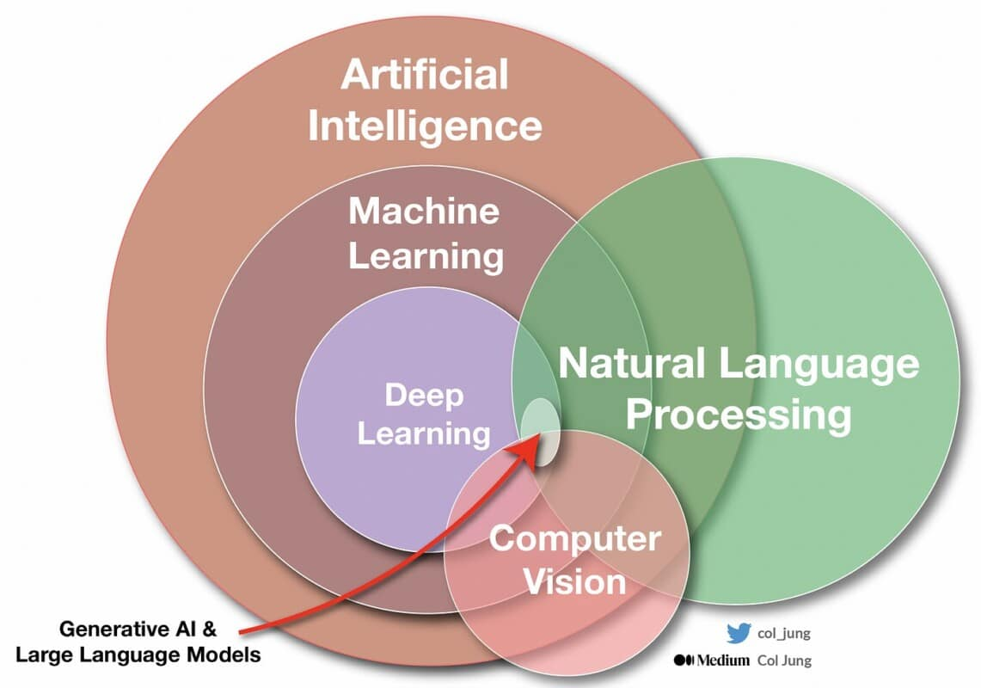
AI : Definitions
AI: Automation involving algorithms to reproduce cognitive capabilities such as reasoning, perception, and decision-making.
ML: Statistical algorithms that automatically learn patterns from data without being explicitly programmed for each task.
DL: Neural networks with multiple layers (millions of parameters) that can learn complex representations from raw data.
source: https://medium.com/geekculture/ai-revolution-your-fast-paced-introduction-to-machine-learning-914ce9b6ddf
Raphael Cousin — Sorbonne University

Slide 3

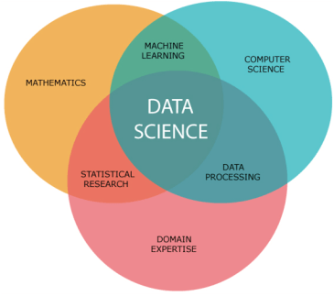
AI : Applications
Raphael Cousin — Sorbonne University

Slide 4
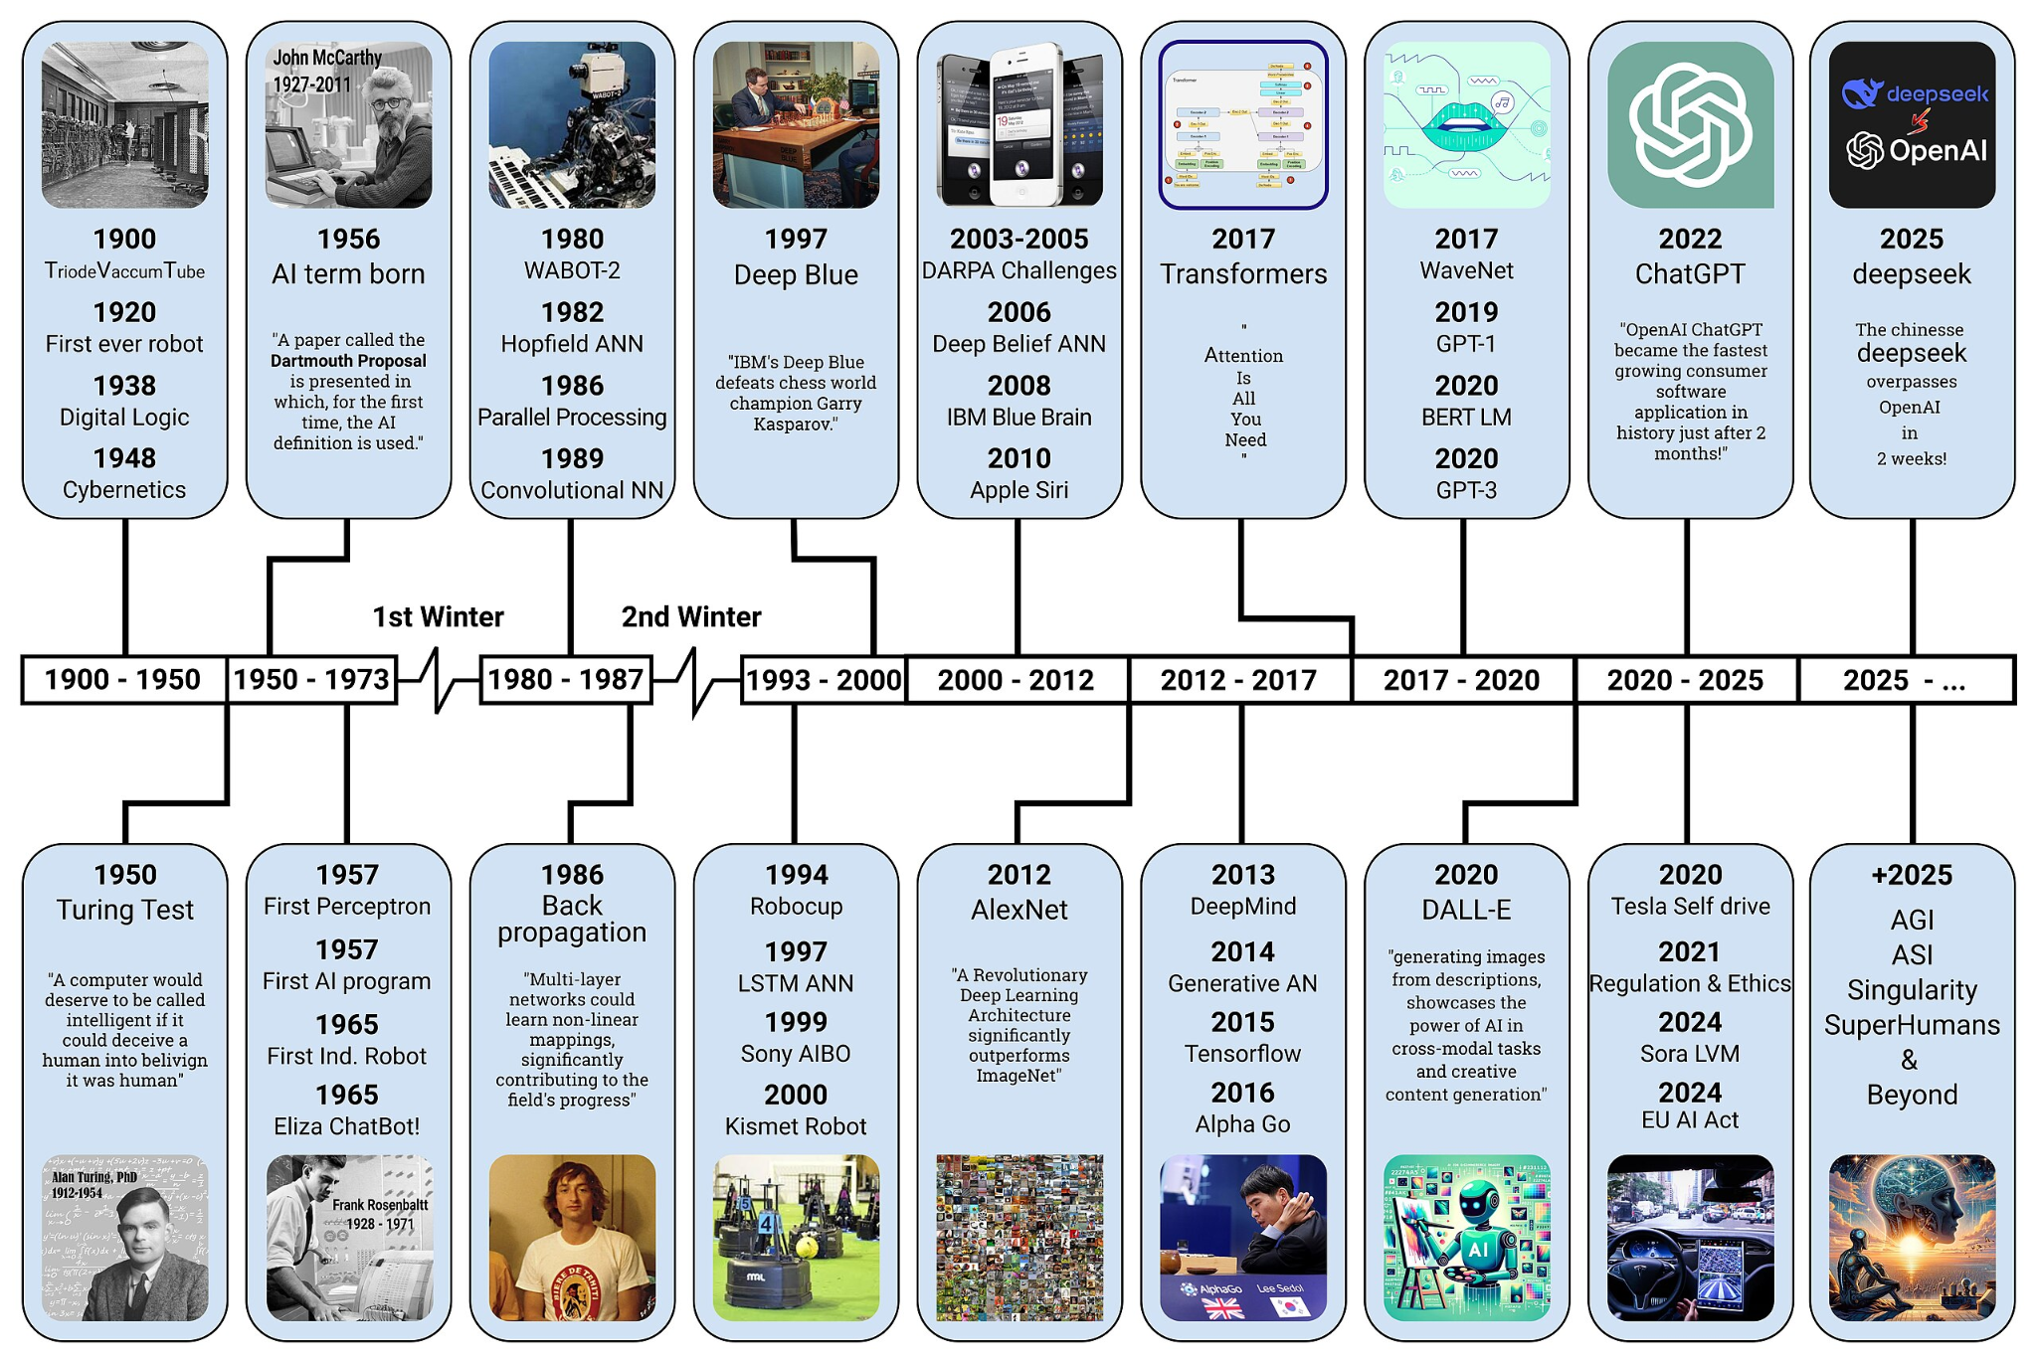

AI : History
Raphael Cousin — Sorbonne University
source: https://commons.wikimedia.org/wiki/File:AI-History-Timeline-300dpi.jpg

Slide 5
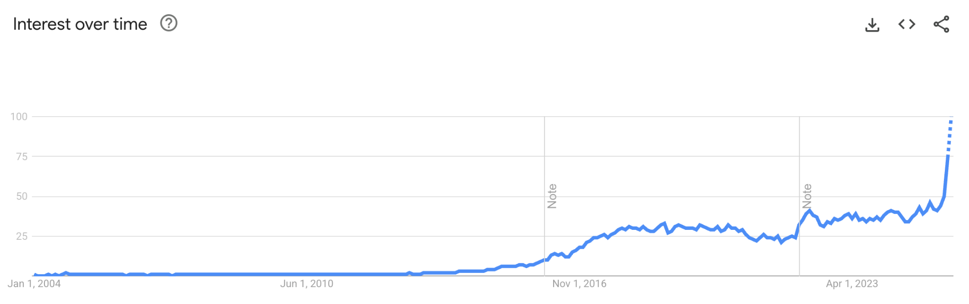
The Deep Learning Revolution
The convergence of three critical factors enabled the deep learning revolution ->
Raphael Cousin — Sorbonne University
Source: https://trends.google.fr/trends/explore?date=all&q=deep%20learning&hl=en

Slide 6
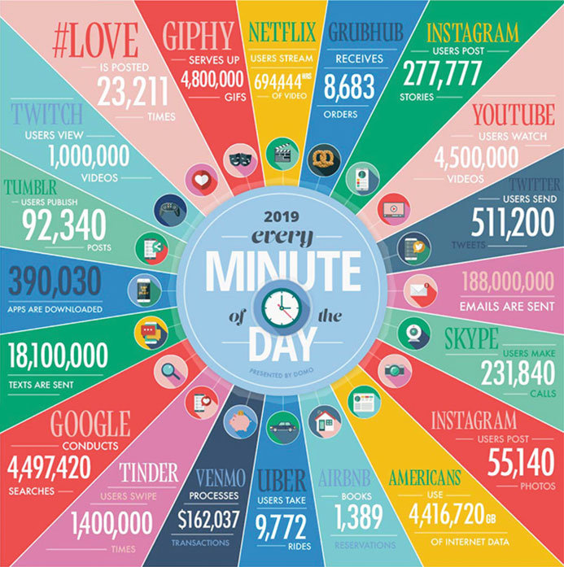
1. Big Data
The internet era generated massive datasets: billions of images, text documents, videos, and user interactions.
This data explosion provided the fuel needed to train complex models that require millions of examples to learn robust patterns.
source: https://medium.com/geekculture/ai-revolution-your-fast-paced-introduction-to-machine-learning-914ce9b6ddf
Raphael Cousin — Sorbonne University

Slide 7
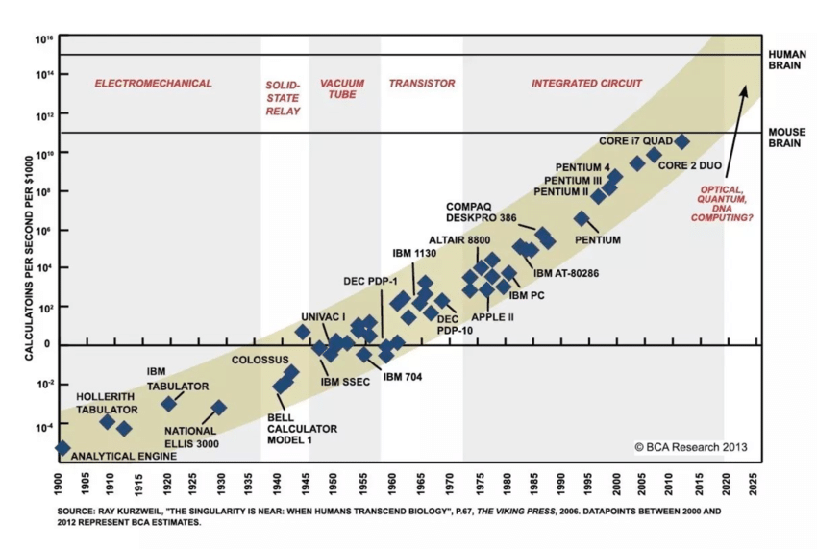
2. Computational Power
GPUs originally designed for gaming proved perfect for neural network computations. A single modern GPU can perform trillions of operations per second, enabling training of models with billions of parameters in days rather than years.
Source: https://www.researchgate.net/figure/The-exponential-progress-of-computing-power-from-1900-to-2013-with-projections-into_fig1_335422453
Raphael Cousin — Sorbonne University

Slide 8
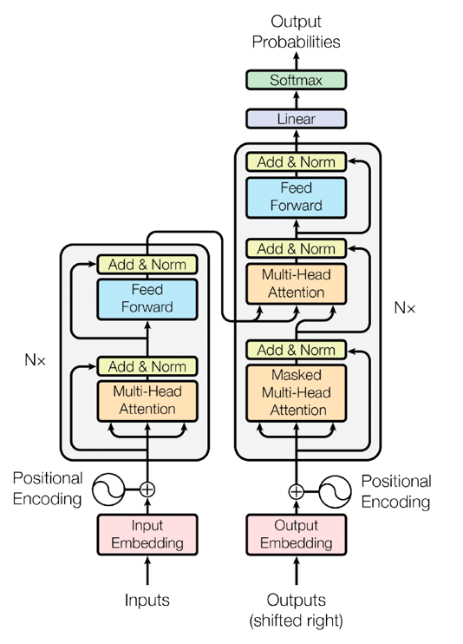

3. Algorithmic Innovation
Breakthrough techniques like ReLU activation, batch normalization, dropout, and attention mechanisms solved critical training challenges.
These innovations made it practical to train networks with dozens or even hundreds of layers. Open source code with big communities.
Raphael Cousin — Sorbonne University
Source: https://en.wikipedia.org/wiki/Transformer_(deep_learning_architecture) Source: https://pytorch.org/

Slide 9

Data: The Fuel of Machine Learning
Volume: Deep networks typically require thousands to millions of training examples.
Bias: Systematic distortions in the data will be learned and reproduced by the model.
Quality: Clean, accurate data are crucial - error will reduce strongly model performances.
Diversity: Training data must capture the full spectrum of real-world scenarios.
Raphael Cousin — Sorbonne University

Slide 10

Data Preprocessing
Steps in Data Preprocessing :
Handle Inconsistencies
Handle Missing Values
Handle Categorical Values
Handle Duplicates
Handle Outliers
Feature Engineering
Scaling and Normalization
Feature Selection and Dimensionality Reduction
Raphael Cousin — Sorbonne University

Slide 11
What is Machine Learning?
"The science of getting computers to learn without being explicitly programmed"
— Arthur Samuel, 1959
Traditional Programming
Machine Learning
A developer writes explicit rules. The computer applies them mechanically to inputs.
You provide data and expected outputs. The machine discovers the rules automatically.
Raphael Cousin — Sorbonne University

Slide 12
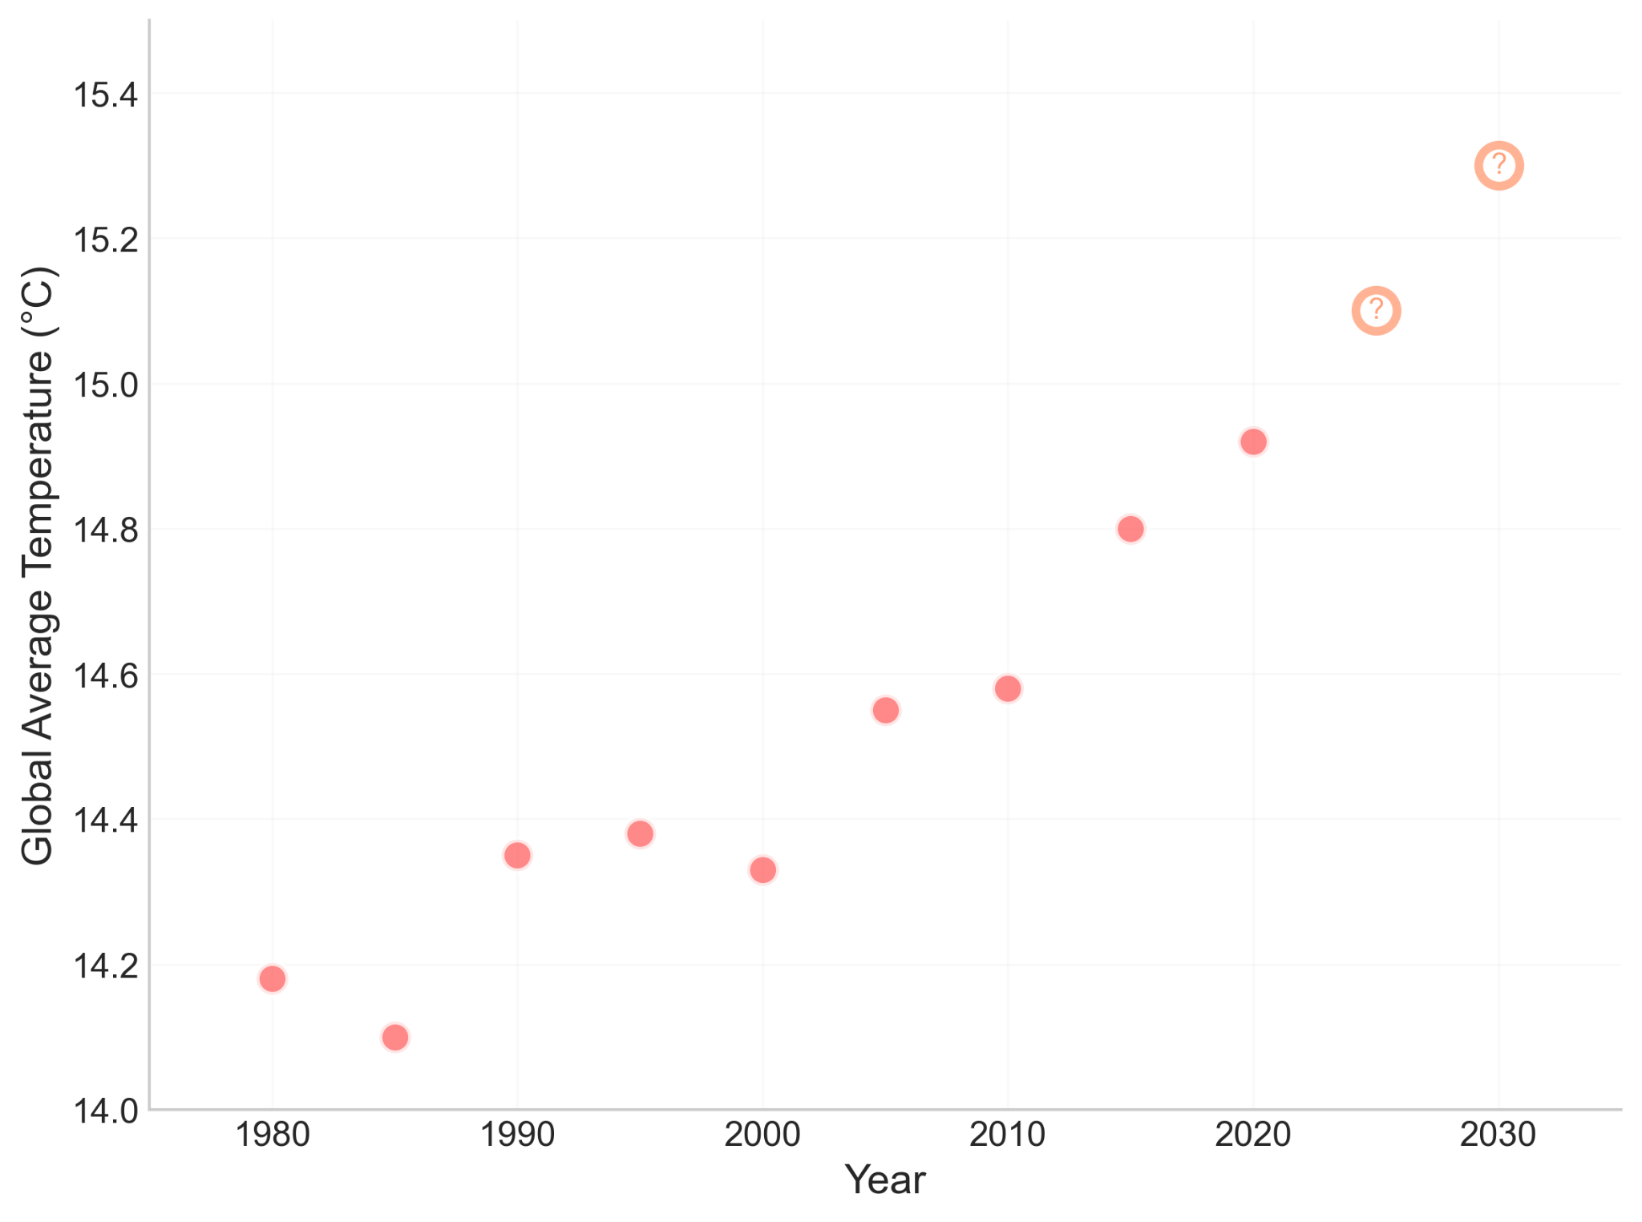
The Machine Learning Objective
Example
Using historical data to predict the future
Raphael Cousin — Sorbonne University

Slide 13
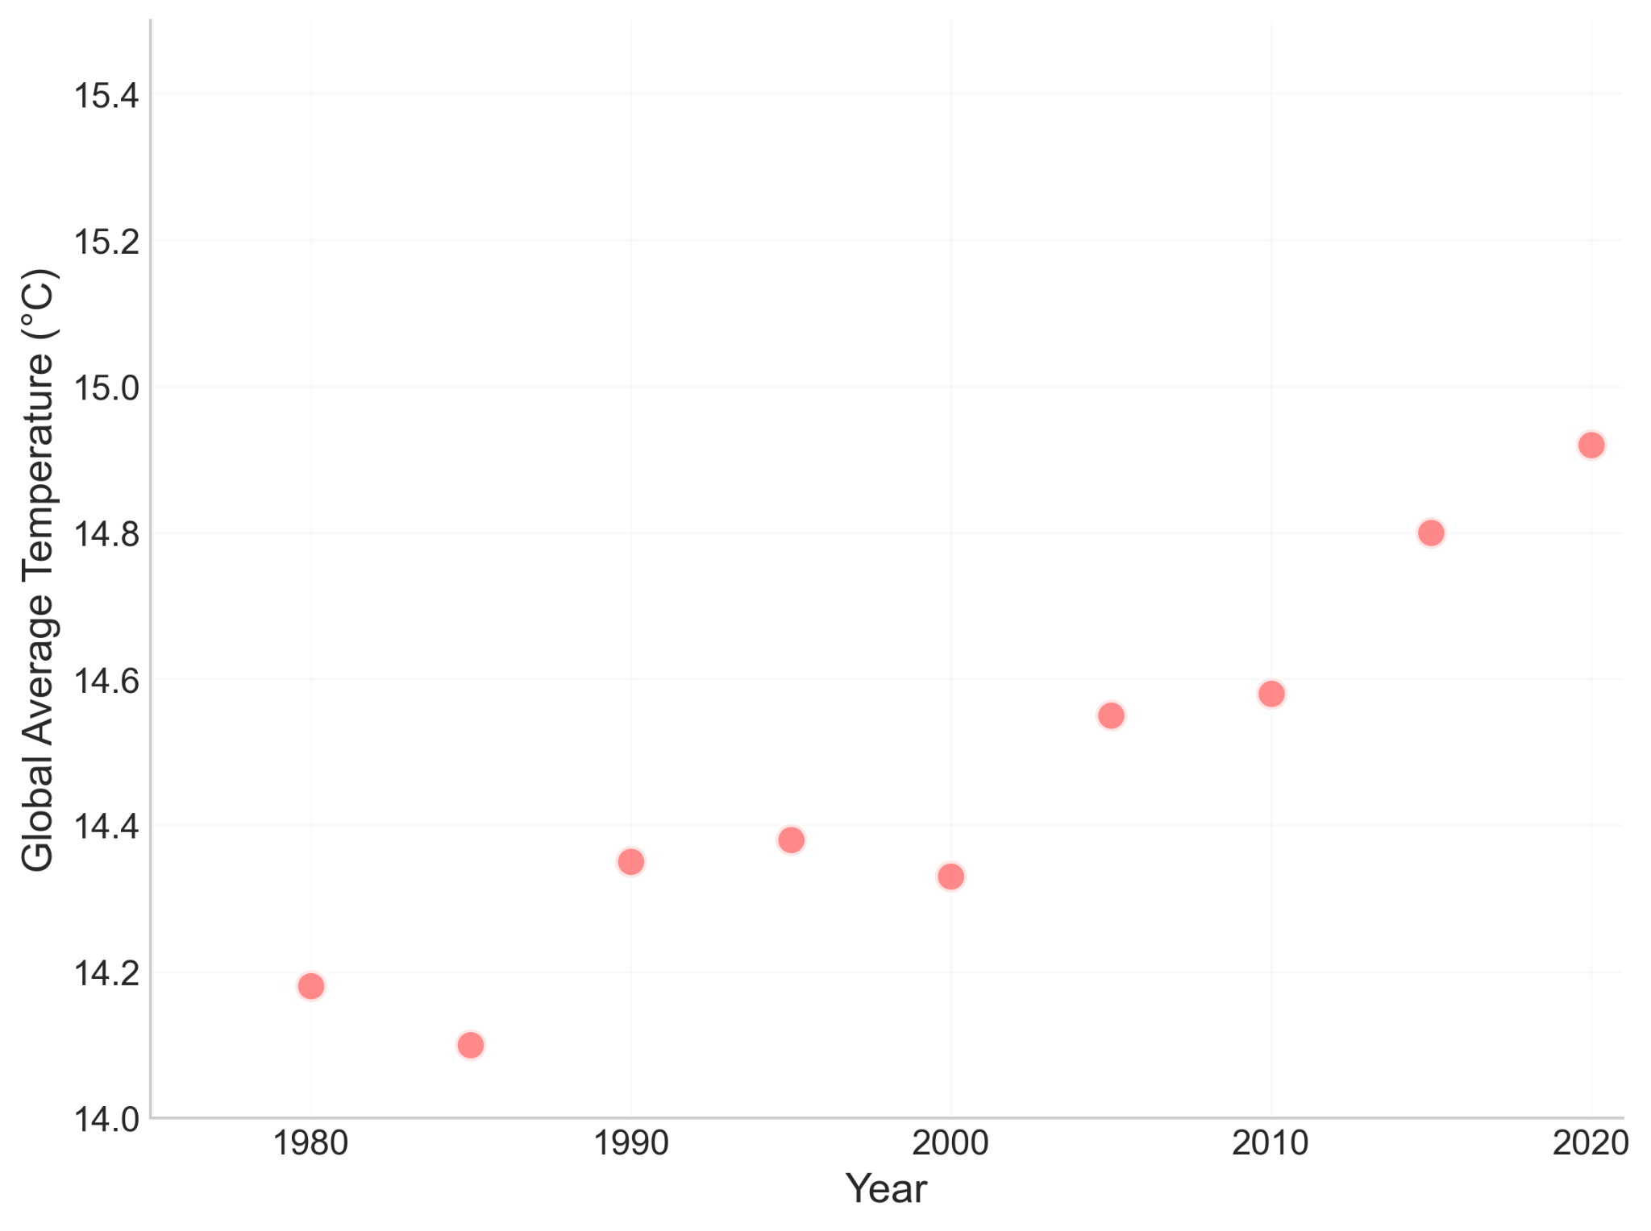
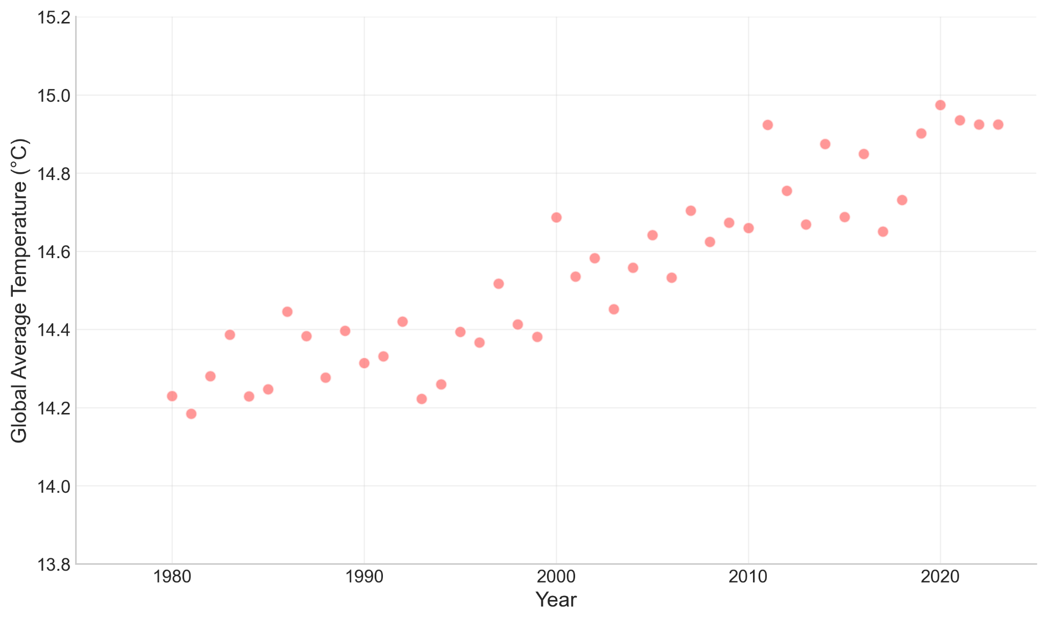


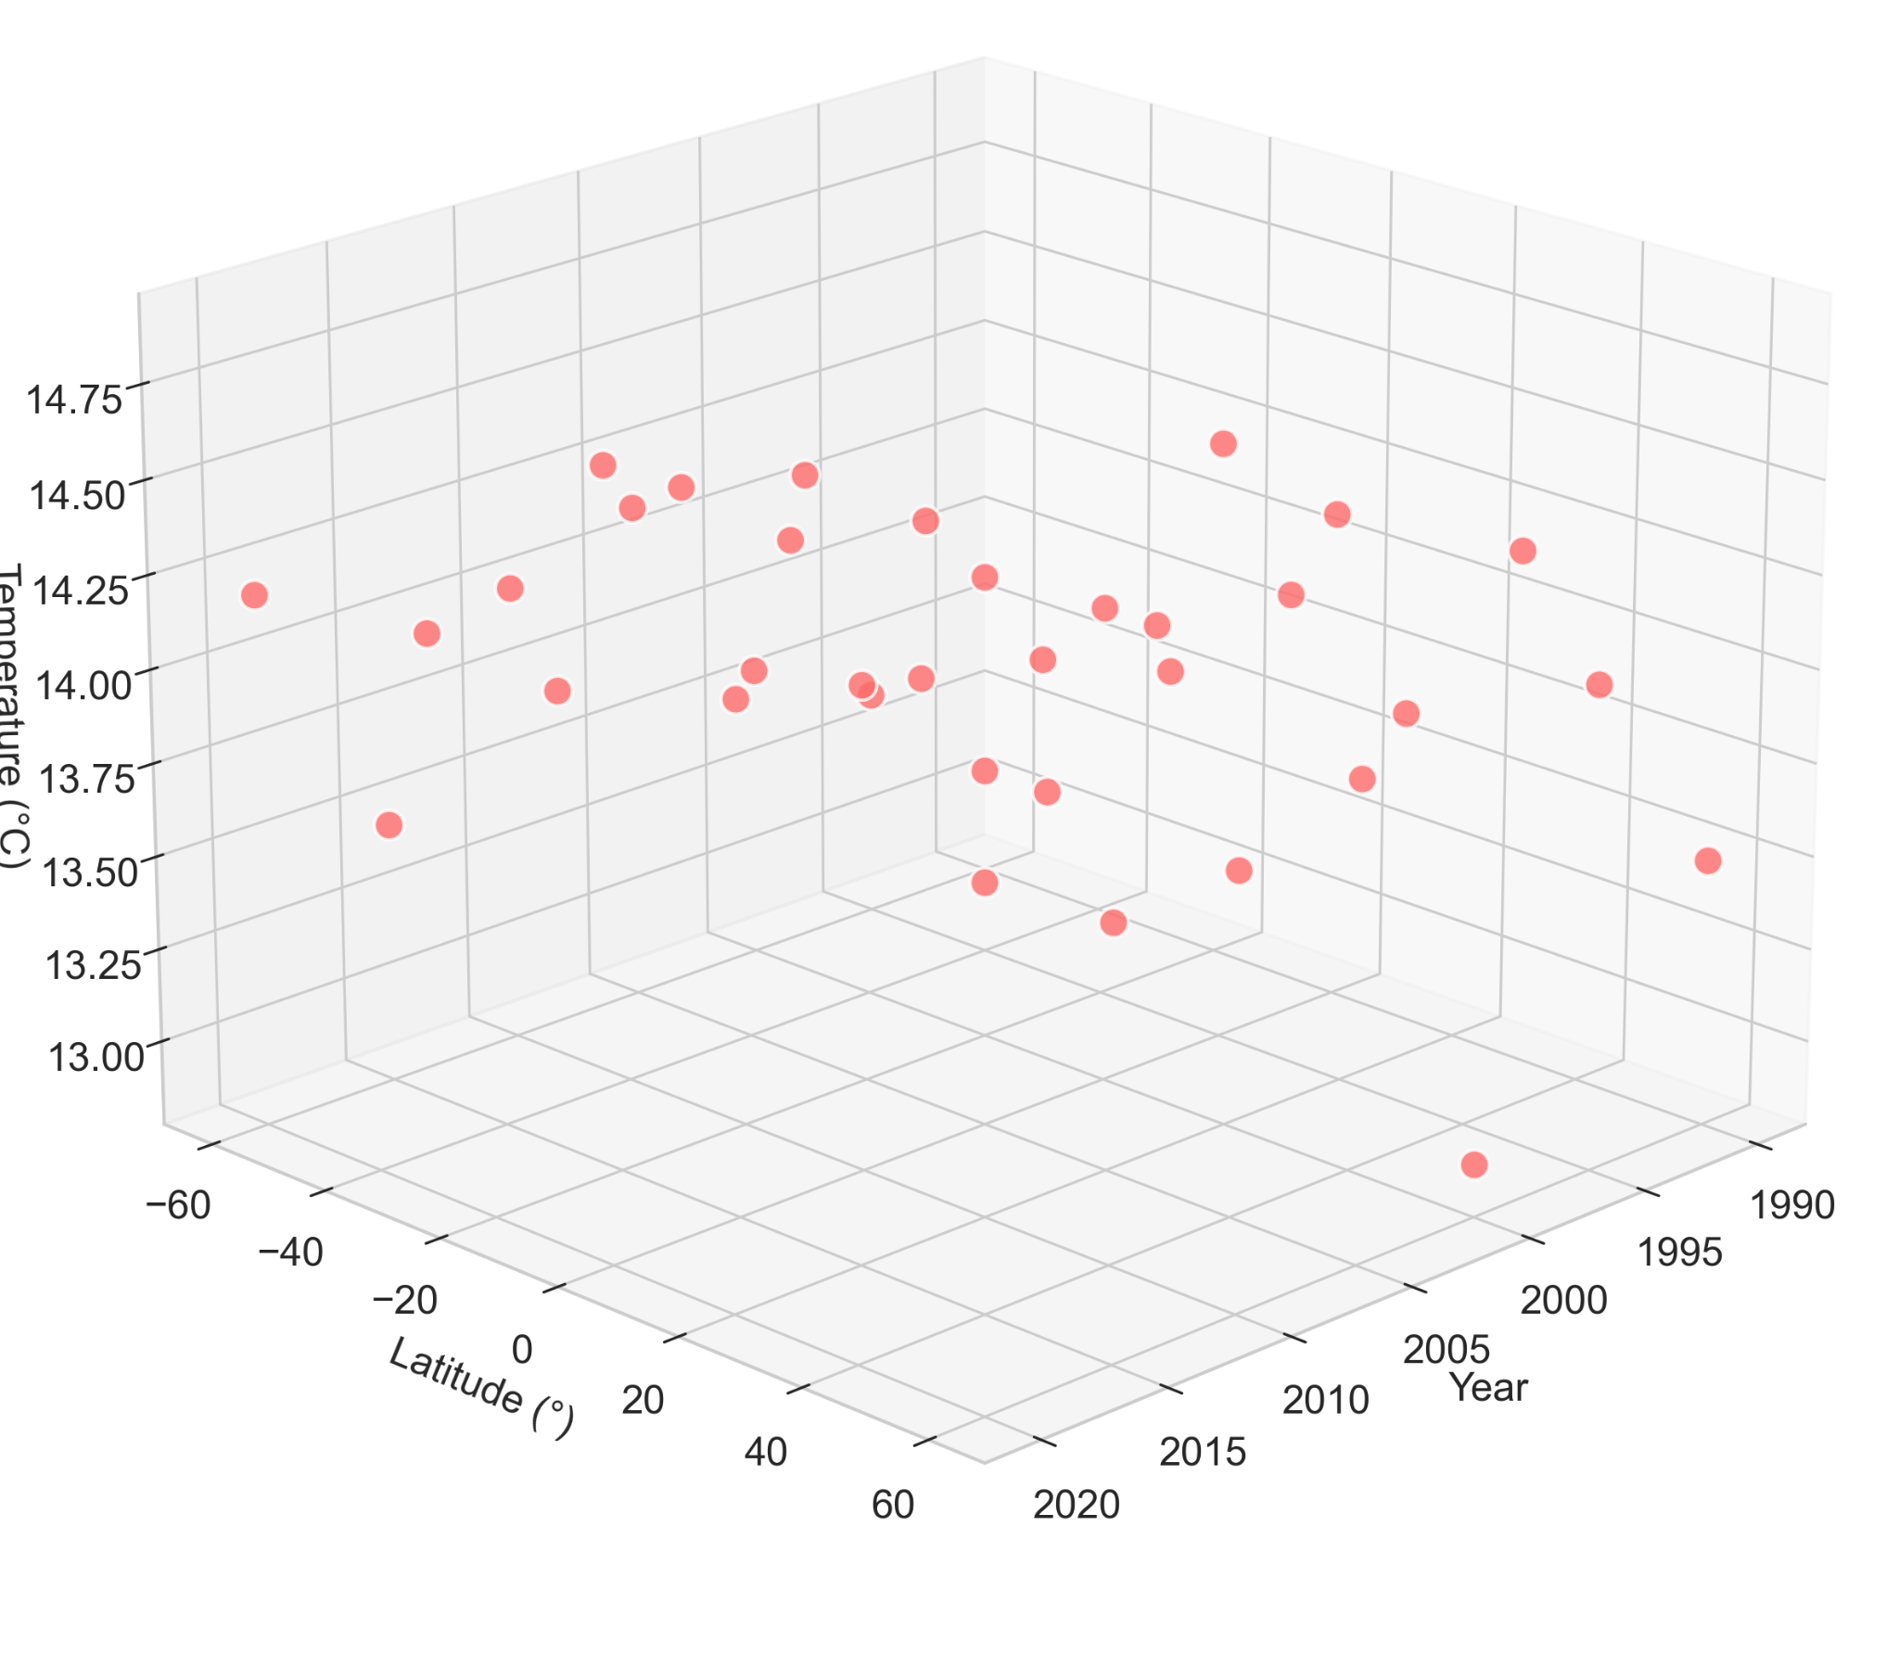
Data Characteristics
Observations : Sample size - number of sample
Dimension: number of variables per observation (features)
9 observations / 2 variables
44 observations / 2 variables
Année | Latitude | Altitude | CO₂ | Humidité | °C
2000 | 45.0 | 200 | 370 | 65 | 13.8
2010 | 30.0 | 800 | 390 | 45 | 12.5
2020 | 60.0 | 50 | 415 | 80 | 14.2
Raphael Cousin — Sorbonne University
3 observations / 6 variables
9 observations / 3 variables

Slide 14
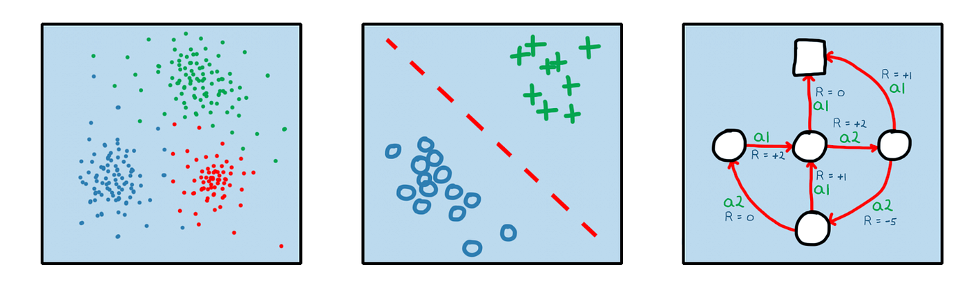
Types of Learning Problems
Unsupervised Learning:
Learning structure from unlabeled
Clustering: Group similar data points
Supervised Learning: Learning from labeled pairs features target
Reinforcement Learning:
Learning through interaction and rewards in an environment
Raphael Cousin — Sorbonne University

Slide 15
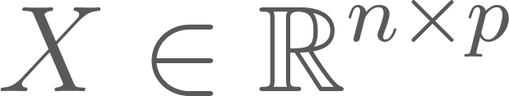


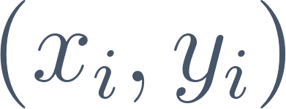
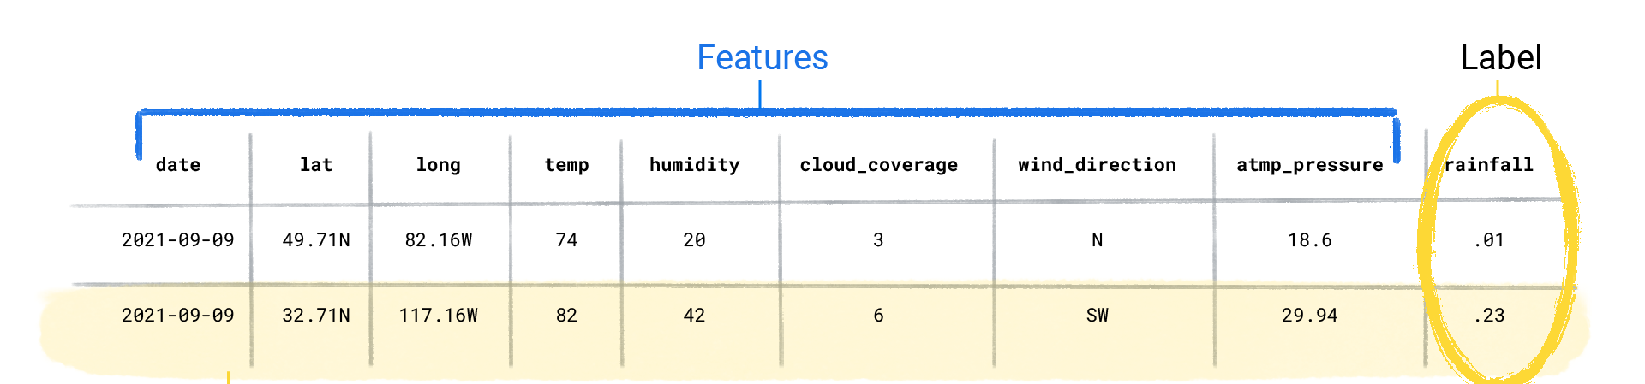
Supervised Learning : Dataset, features and target/label
Explanatory variables (features/characteristics)
Variable to explain (target)
Dataset A sample / An observation
Raphael Cousin — Sorbonne University

Slide 16
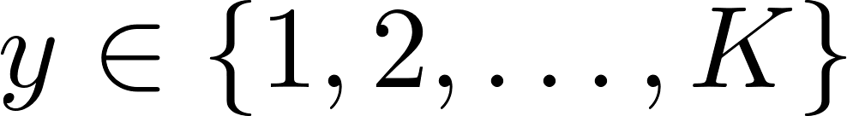

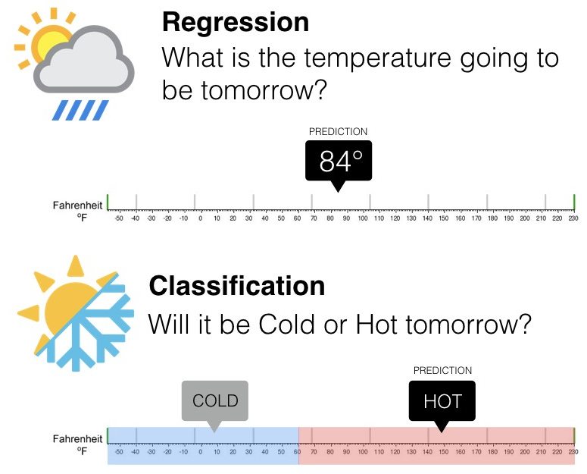
Supervised Learning: Two Tasks
Classification
Regression
Predict a category
Predict a continuous value
Raphael Cousin — Sorbonne University

Slide 17
Examples
Medical Diagnosis
House Prices
Fraud Detection
Classification
Regression
Classification
Weather Prediction
Image Recognition
Stock Forecasting
Regression
Classification
Regression
Raphael Cousin — Sorbonne University

Slide 18





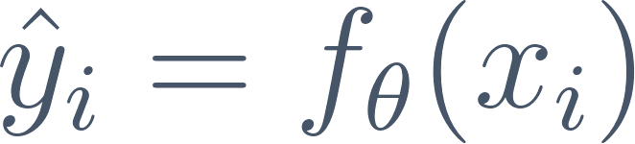



Parametric Models characteristics
Model = Function
Parameters
Prediction
A model maps p input features to a prediction. It is parameterized by
Number of values the model must learn
The hat (^) means "estimated". The goal: make as close to as possible.
Raphael Cousin — Sorbonne University

Slide 19
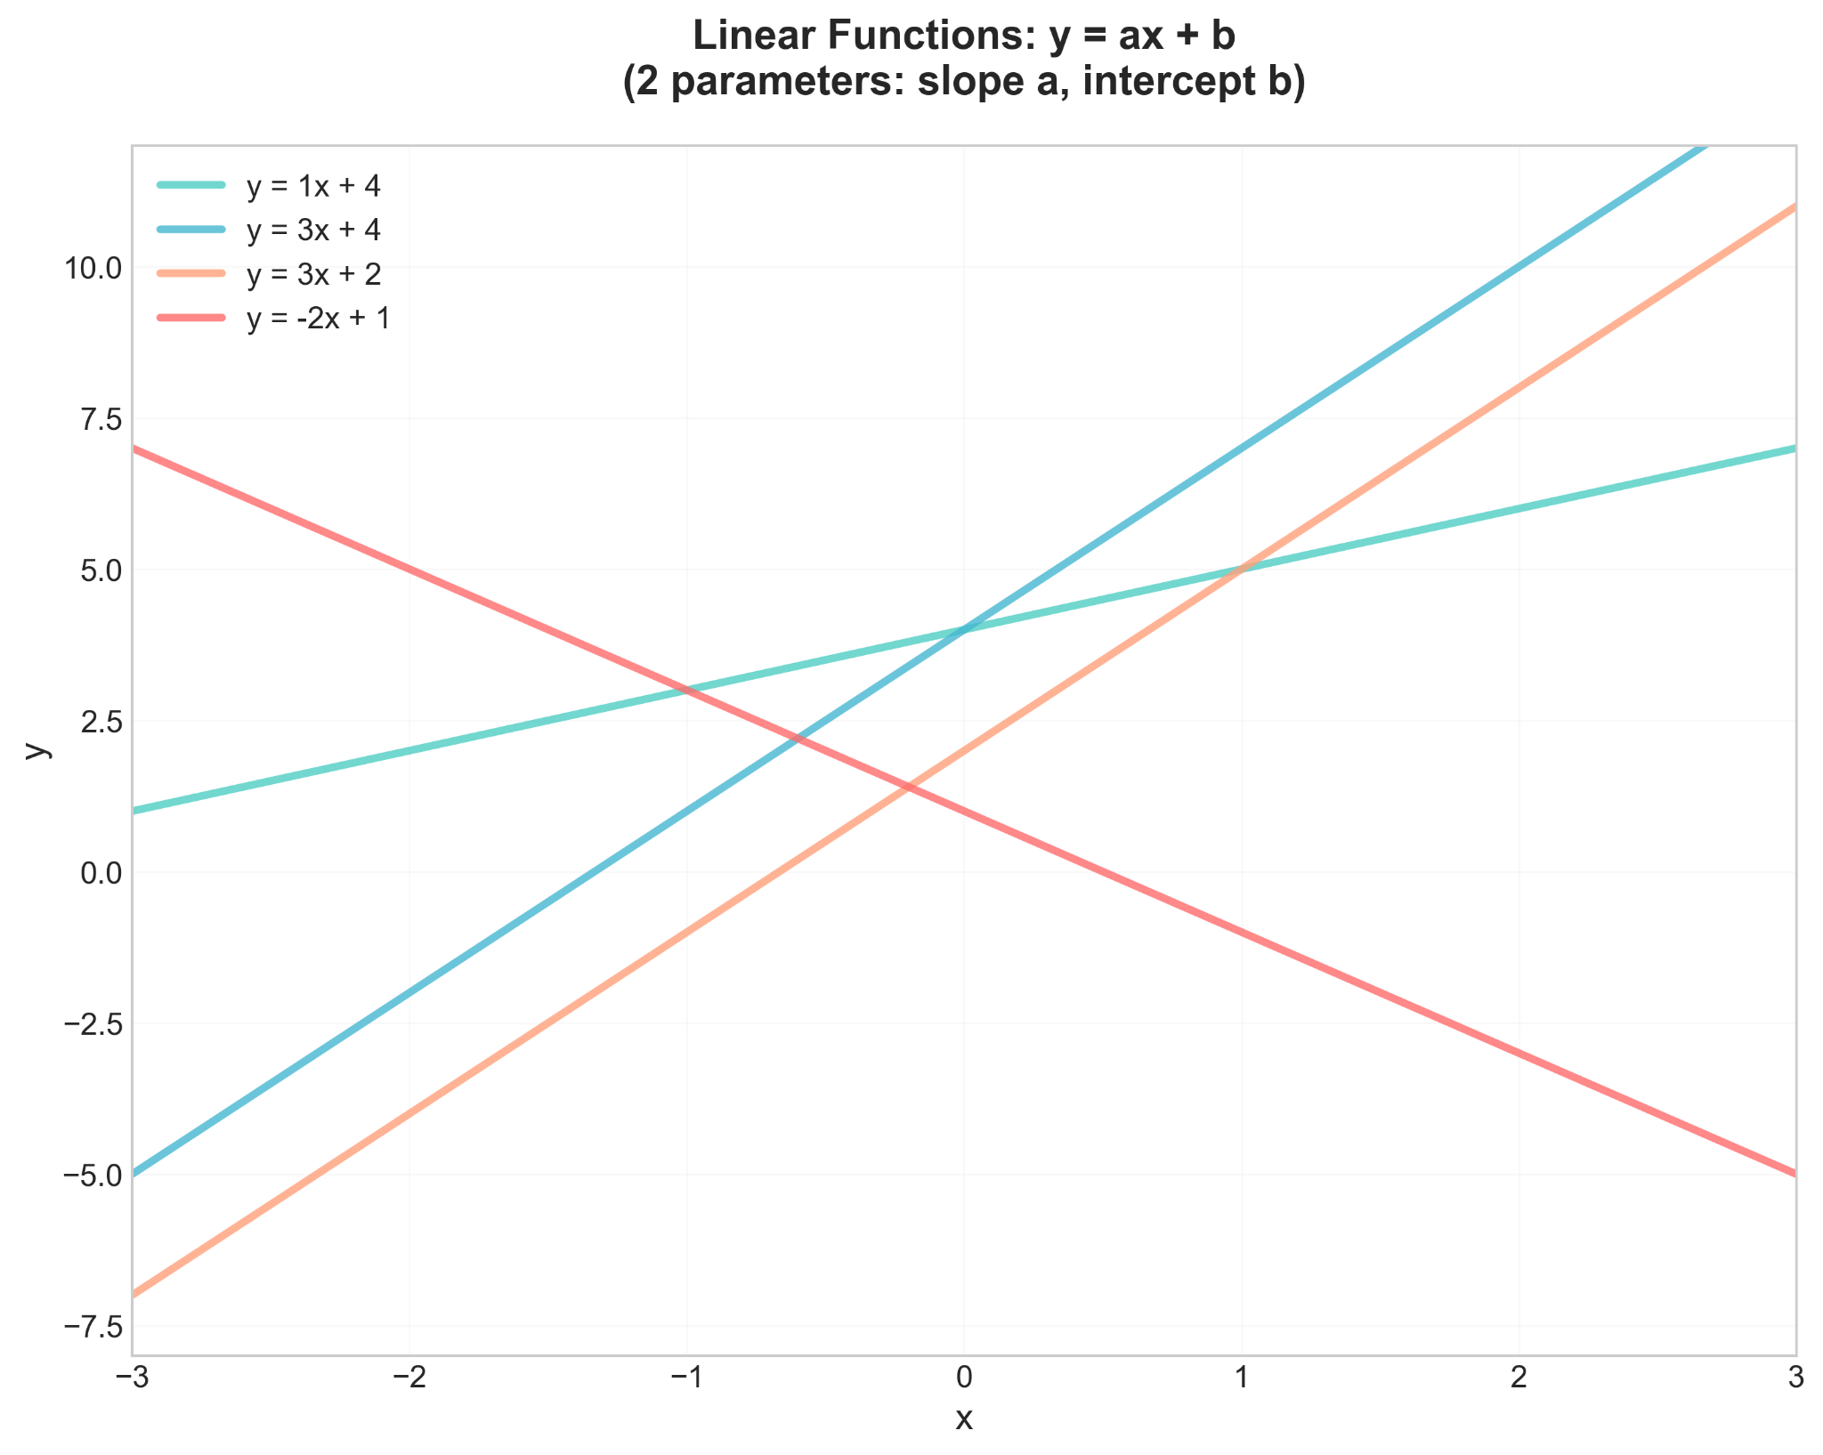
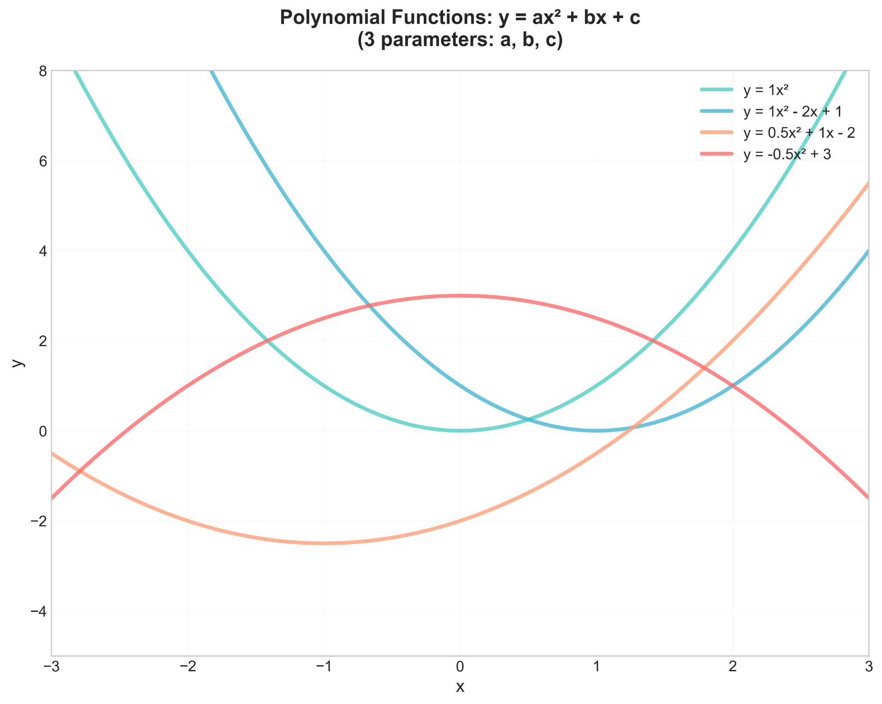


Parametric Models examples
Raphael Cousin — Sorbonne University

Slide 20
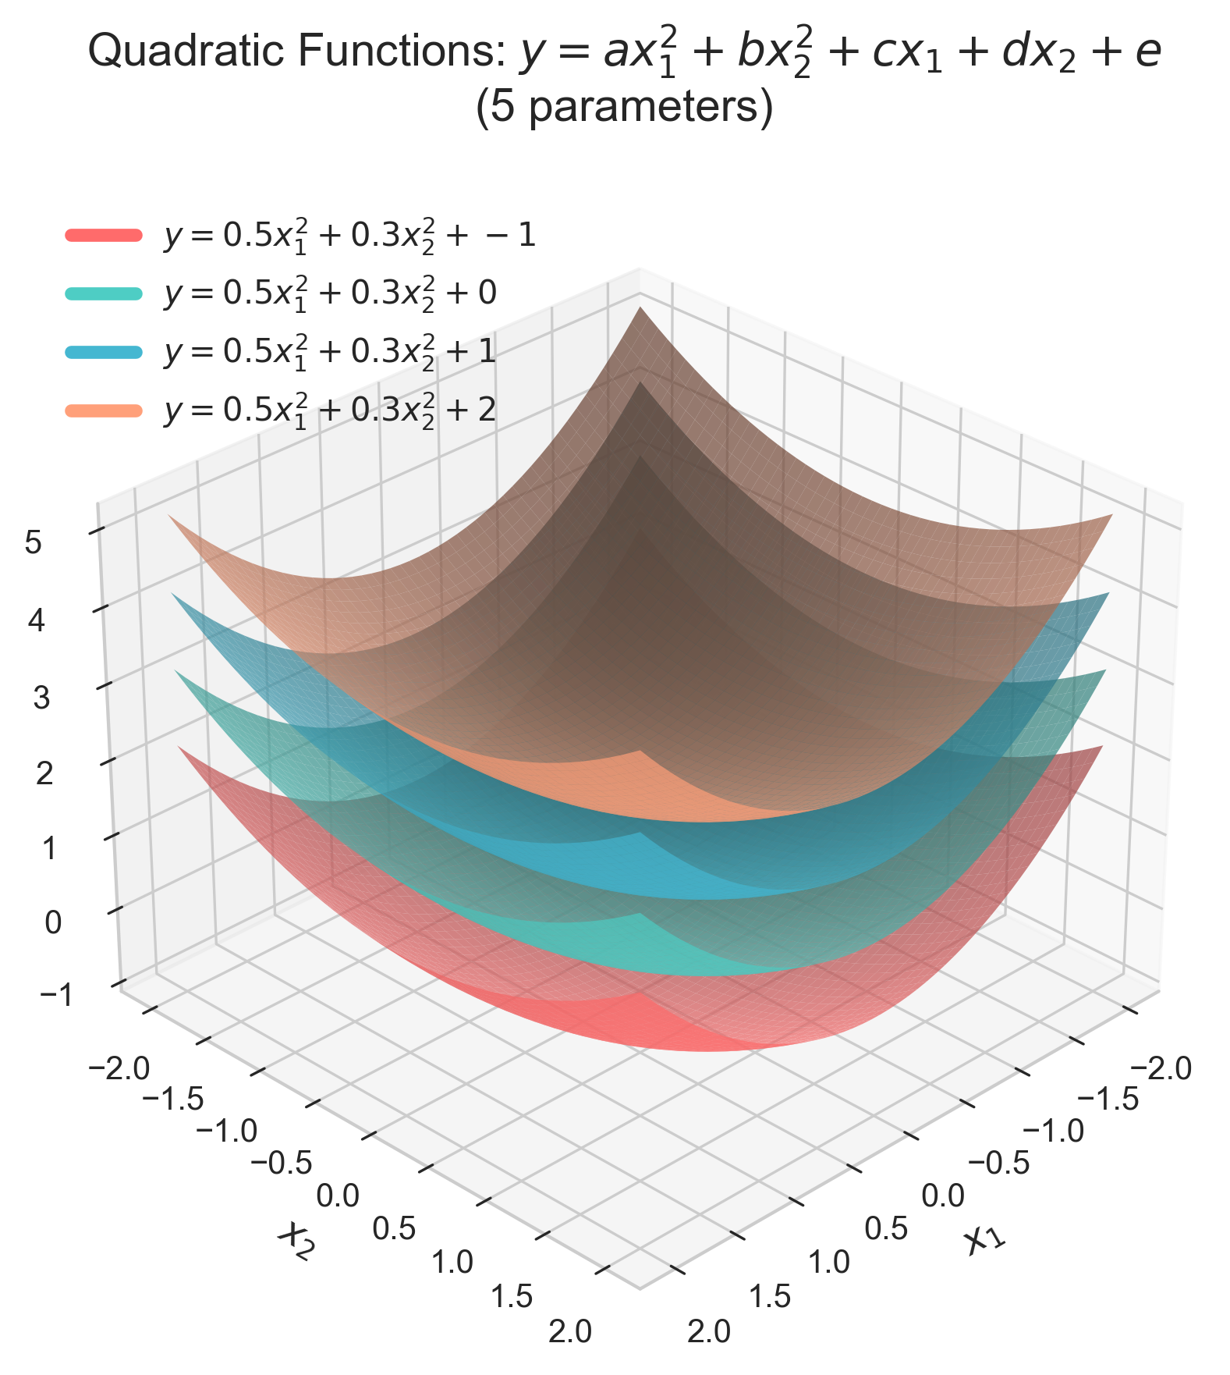
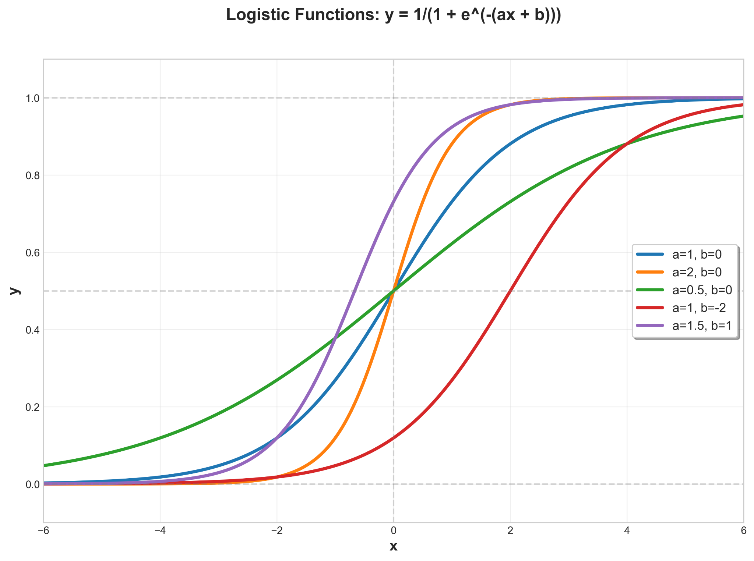
Parametric Models examples
Raphael Cousin — Sorbonne University

Slide 21
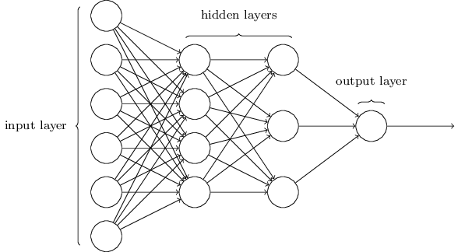
Parametric Models examples
Raphael Cousin — Sorbonne University

Slide 22
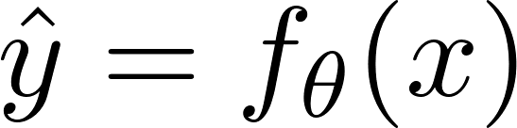
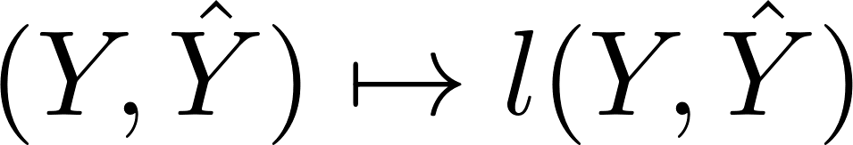
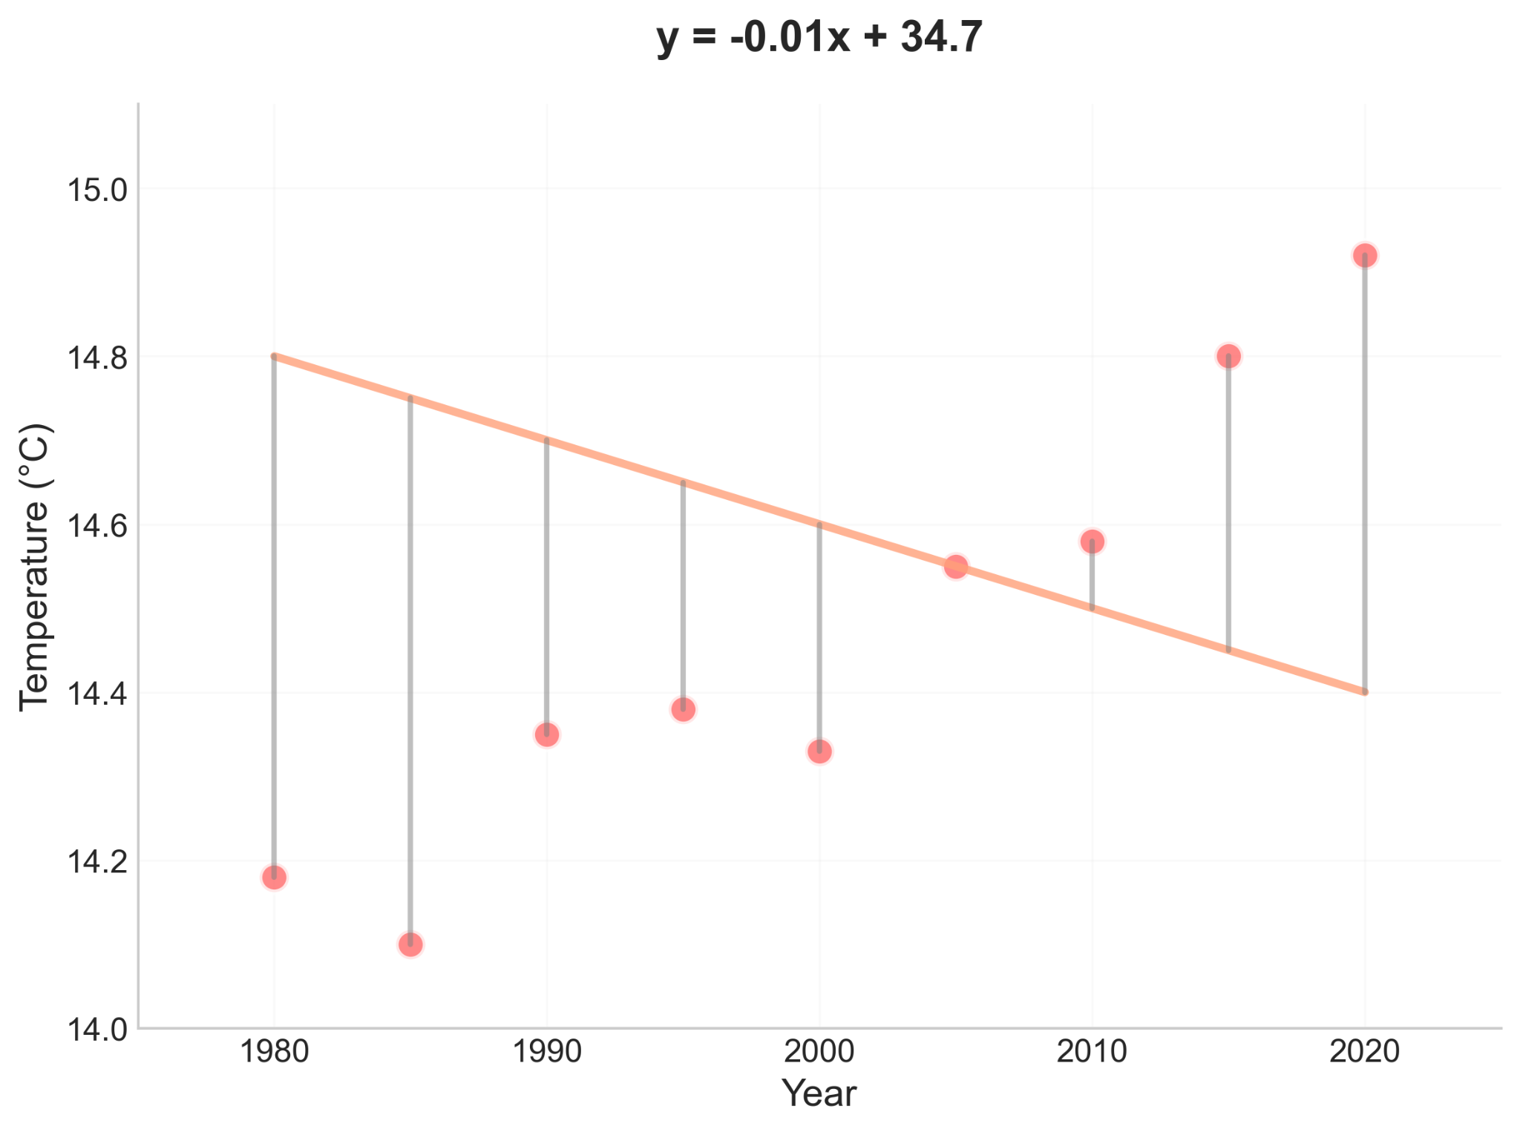
Loss Functions characteristics
The Role of Loss Functions Loss functions quantify the error/distance between real targets and predictions
Example Loss Functions
Mean Squared Error
Raphael Cousin — Sorbonne University

Slide 23
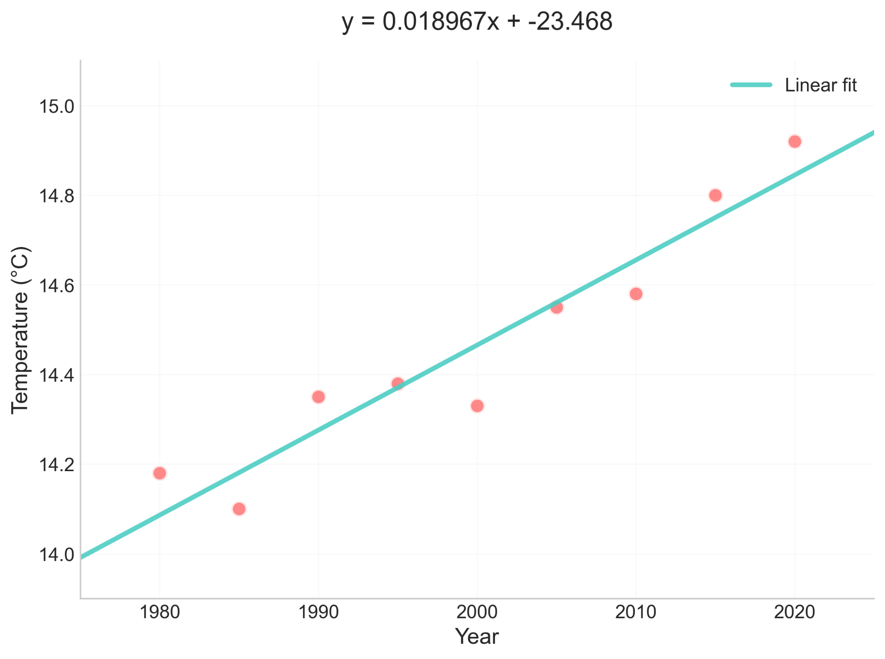
The Fundamental Learning Problem
For a given parametric mode machine learning seeks to find the parameters that minimize the loss between real and predicted value :
Raphael Cousin — Sorbonne University

Slide 24

The Learning Process
1
2
3
4
5
Data
→
Model
→
Loss
→
Optimize
→
Collect
samples
Choose
family
Define
error
Minimize
loss
Learned
params
Key Insight
Every supervised ML algorithm follows this template — whether linear regression or a deep neural network. The differences lie in the model family (step 2) and the optimization strategy (step 4).
Raphael Cousin — Sorbonne University

Slide 25
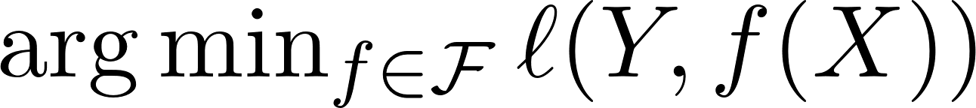
Same Objective, Different Ways to Learn
OBJECTIVE: Make good predictions
Analytical Solution
Gradient Descent
Memory-Based
Solve equations directly
(Normal equation)
Iterative optimization
Follow the steepest slope
KNN — just memorize
Course 1
Course 1
Course 2
Margin-Based
Sequential Correction
Maximize decision margin
(SVM)
Build models that fix
each other's mistakes (Boosting)
Course 2
Course 3
Raphael Cousin — Sorbonne University

Slide 26
Gradient Descent

Slide 27
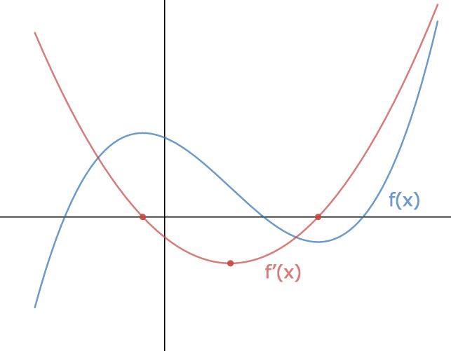
Derivatives and Gradients
Derivative (1D):
Measures how much a function changes when its input changes
Gradient (Multi-dimensional):
Extension of derivative to functions with multiple inputs ∇f = [∂f/∂x₁, ∂f/∂x₂, ..., ∂f/∂xₙ]
Points in the direction of steepest increase of the function
Raphael Cousin — Sorbonne University

Slide 28
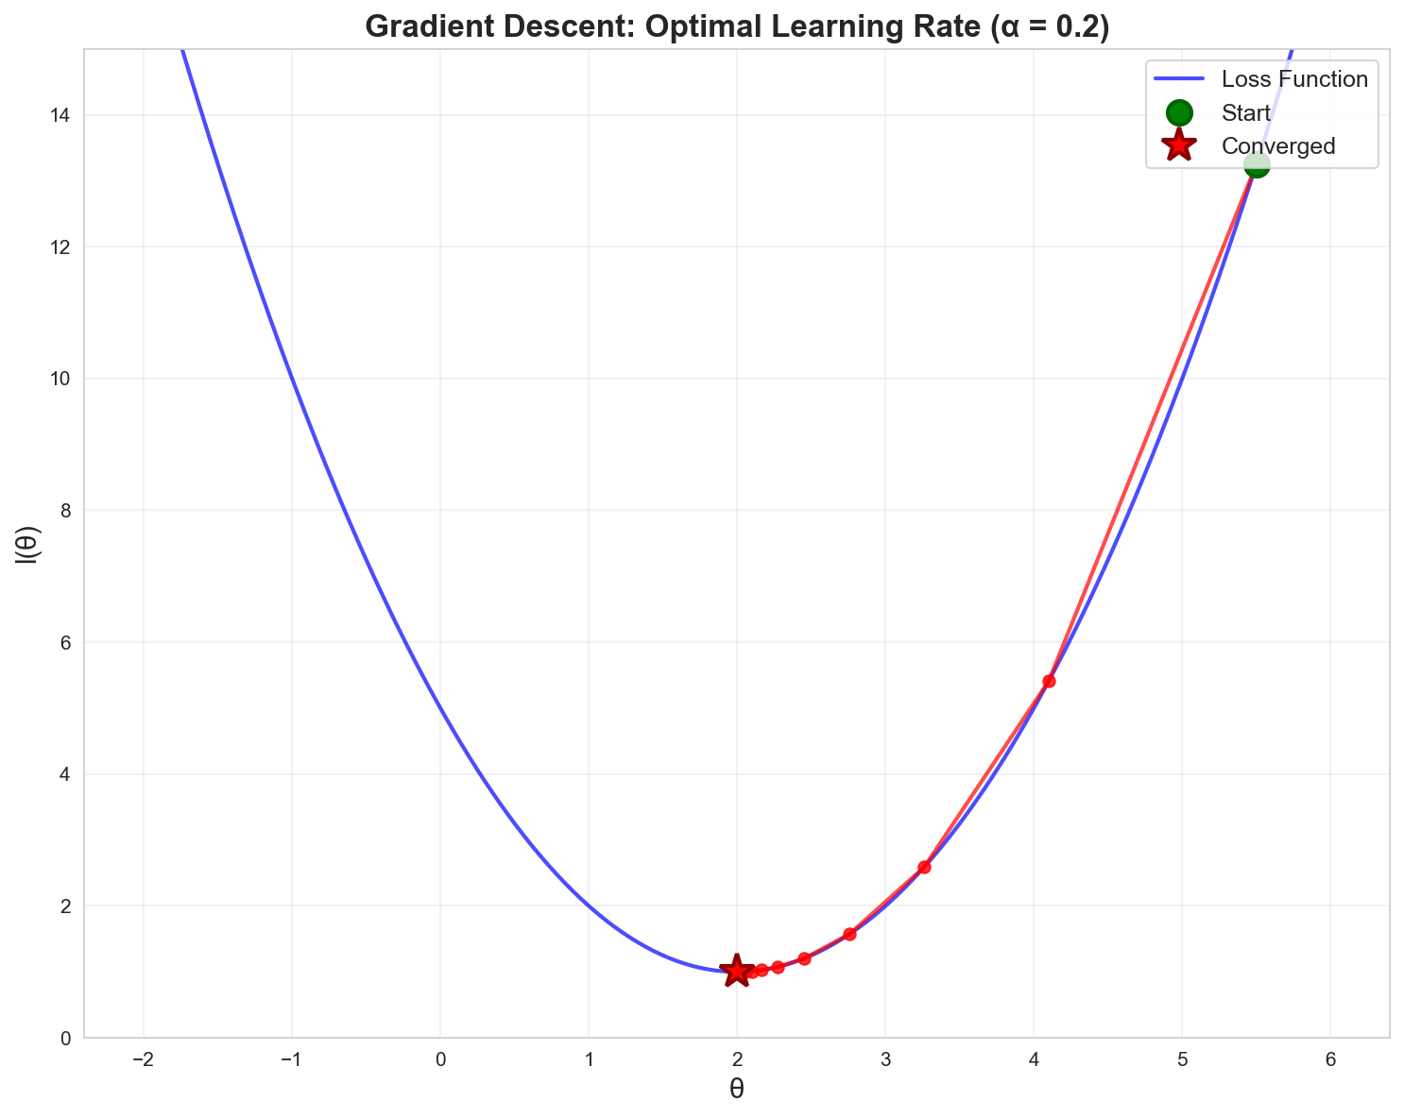
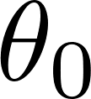
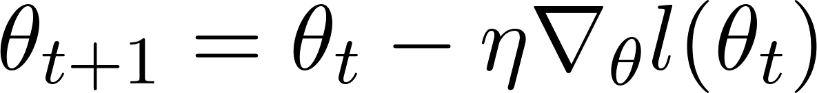
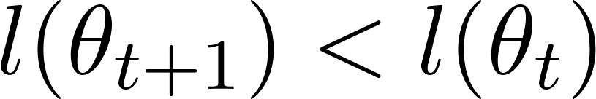
Gradient Descent and Optimization
0. Initialization
Initialize
Initialize parameters randomly
1. Update Rule
1. Iterate
Repeat 1. while
Raphael Cousin — Sorbonne University

Slide 29
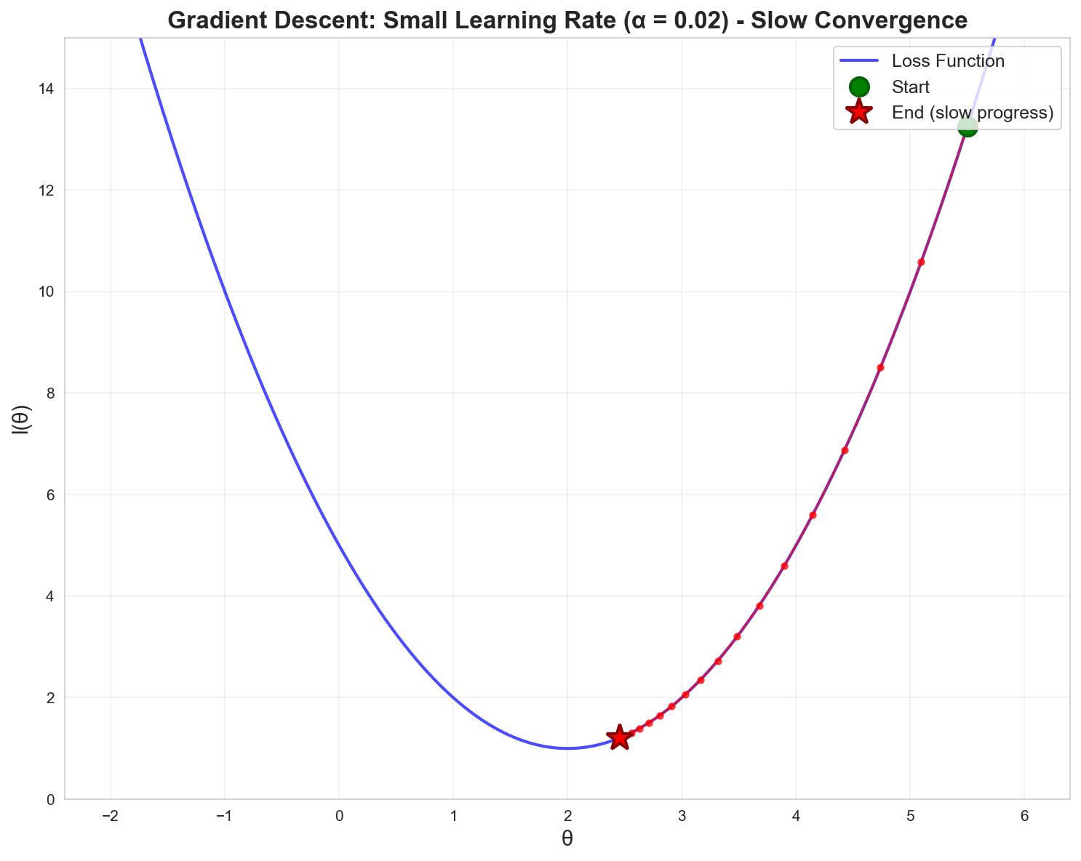
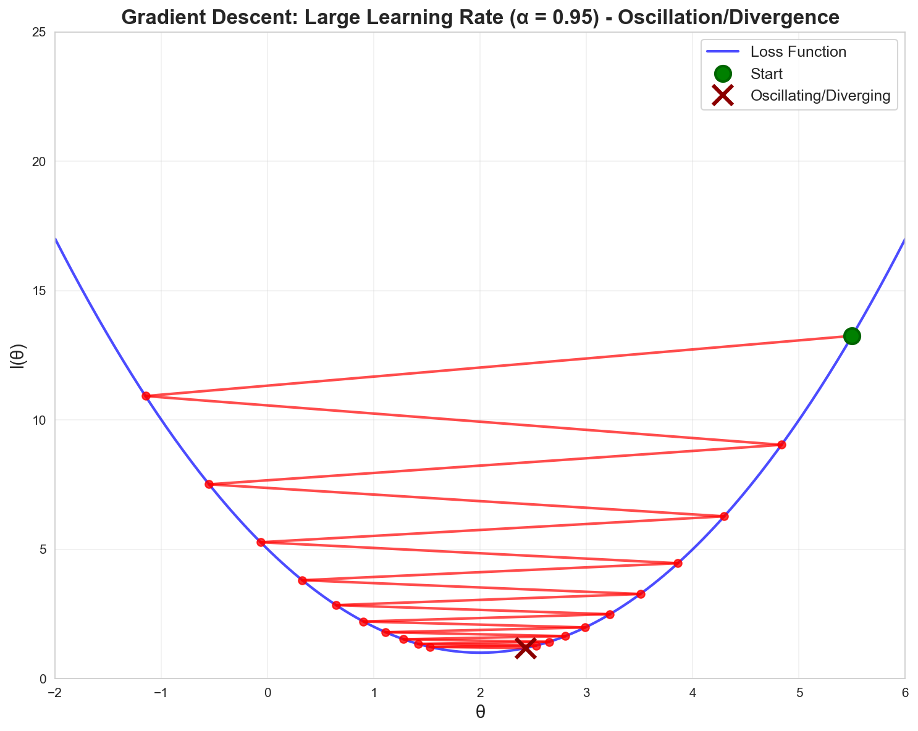
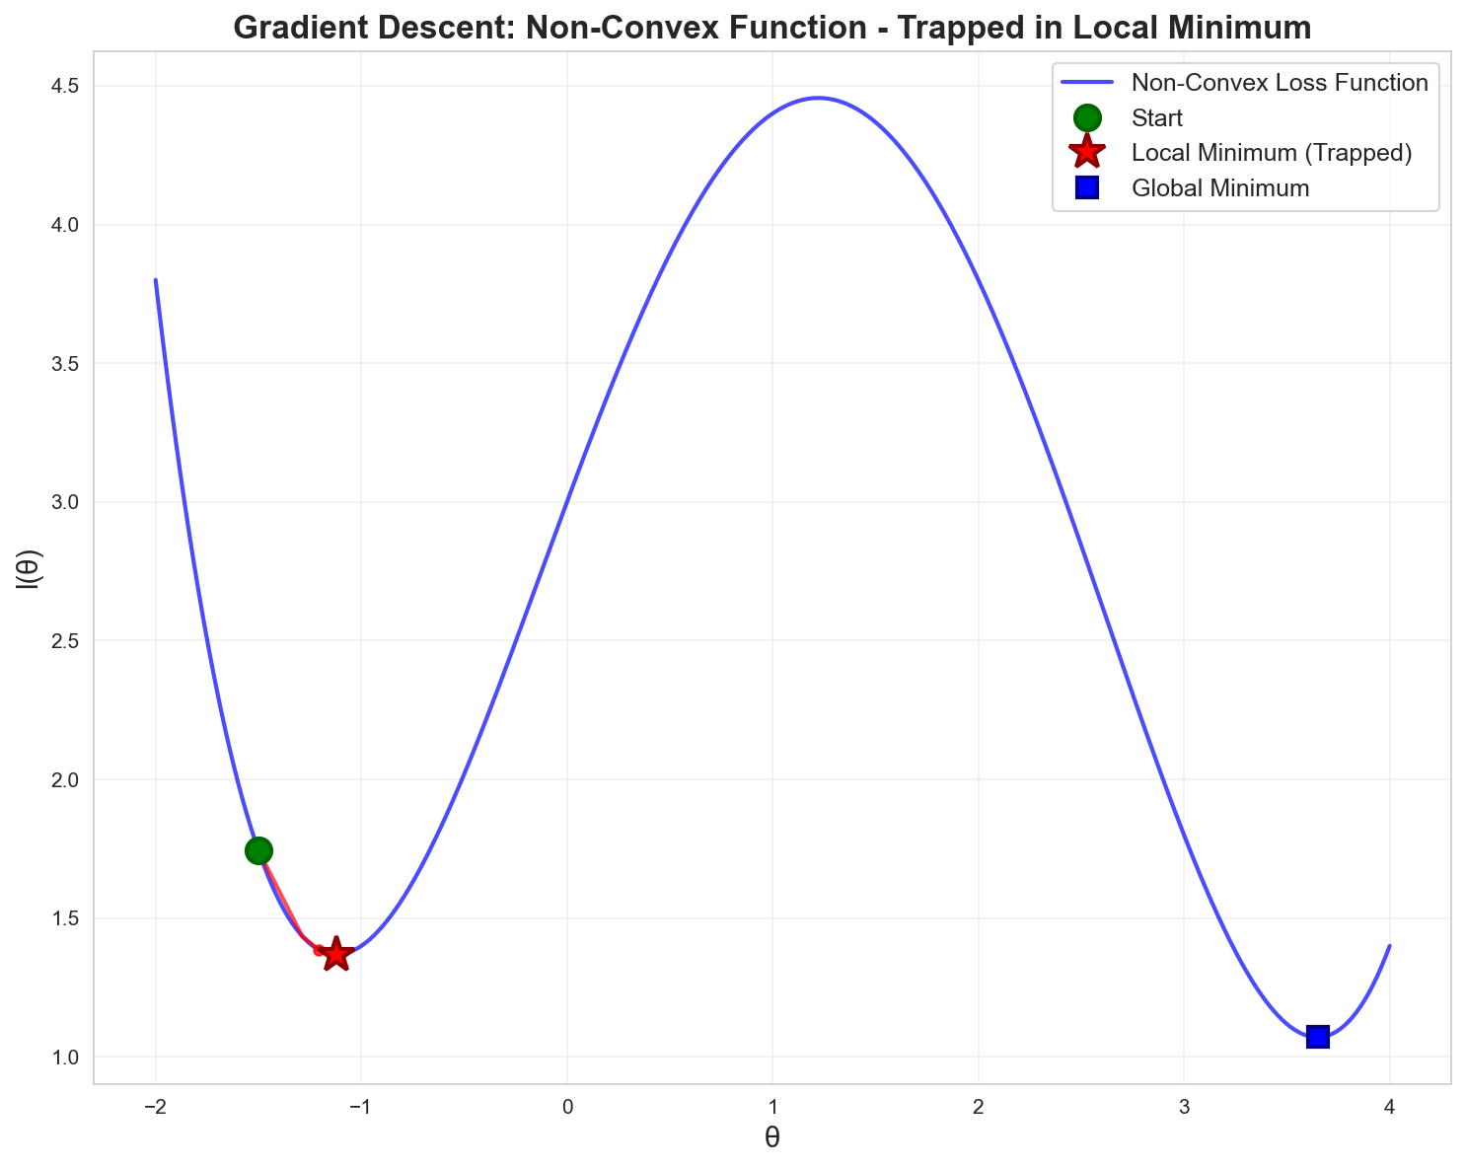
Hyperparameter - Learning rate
Hyperparameters: are settings chosen that control how a model learns
Raphael Cousin — Sorbonne University

Slide 30
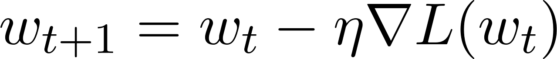
Optimizers : how do we update the gradient
Gradient Descent:
Gradient Descent + Momentum:
Raphael Cousin — Sorbonne University

Slide 31
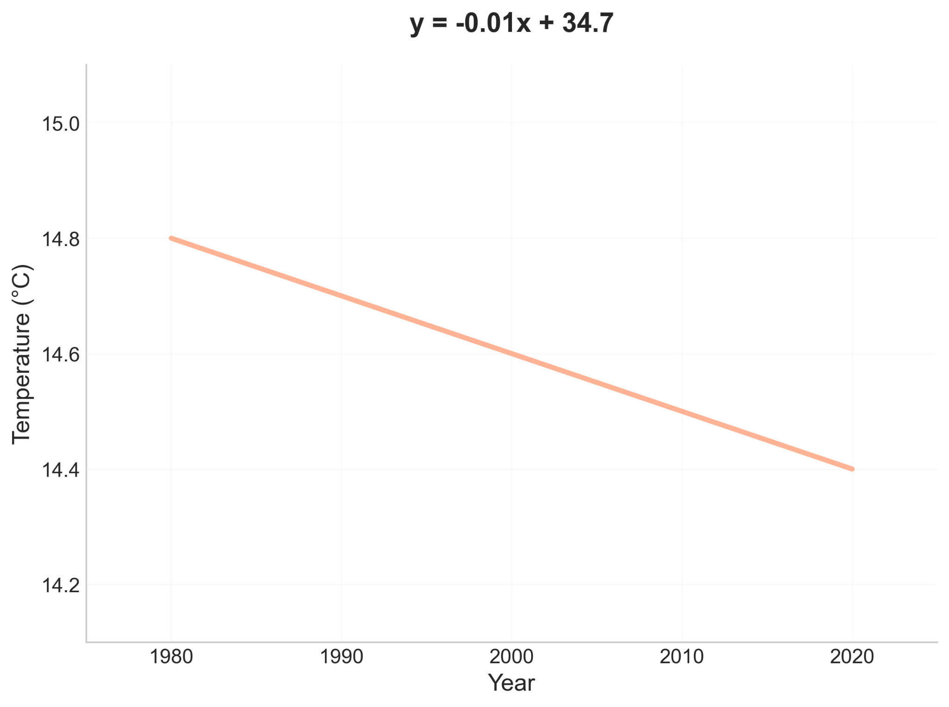
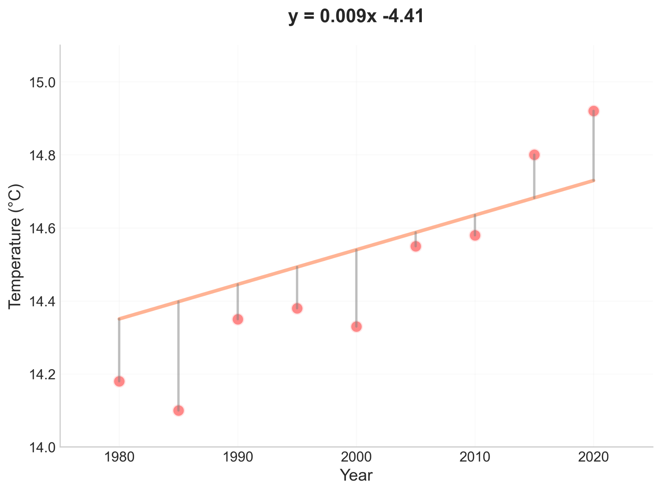
Compute loss/error gradient
Year | Y_true | Y_pred | Error
1980 | 14.18 | 14.80 | 0.62
1985 | 14.10 | 14.75 | 0.65
1990 | 14.35 | 14.70 | 0.35
1995 | 14.38 | 14.65 | 0.27
2000 | 14.33 | 14.60 | 0.27
2005 | 14.55 | 14.55 | 0.00
2010 | 14.58 | 14.50 | 0.08
2015 | 14.80 | 14.45 | 0.35
2020 | 14.92 | 14.40 | 0.52
Initialisation
q
Update params (gradient descent)

Slide 32
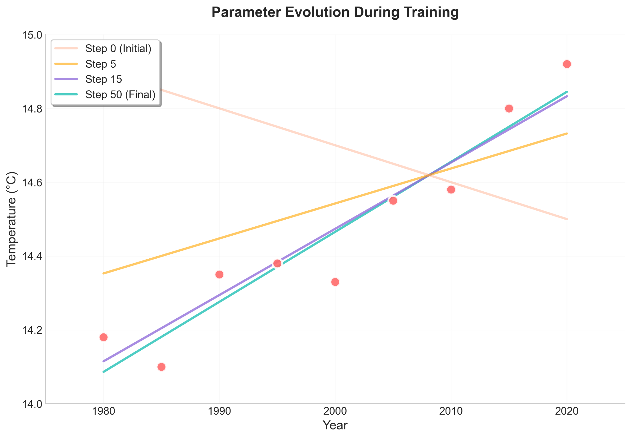
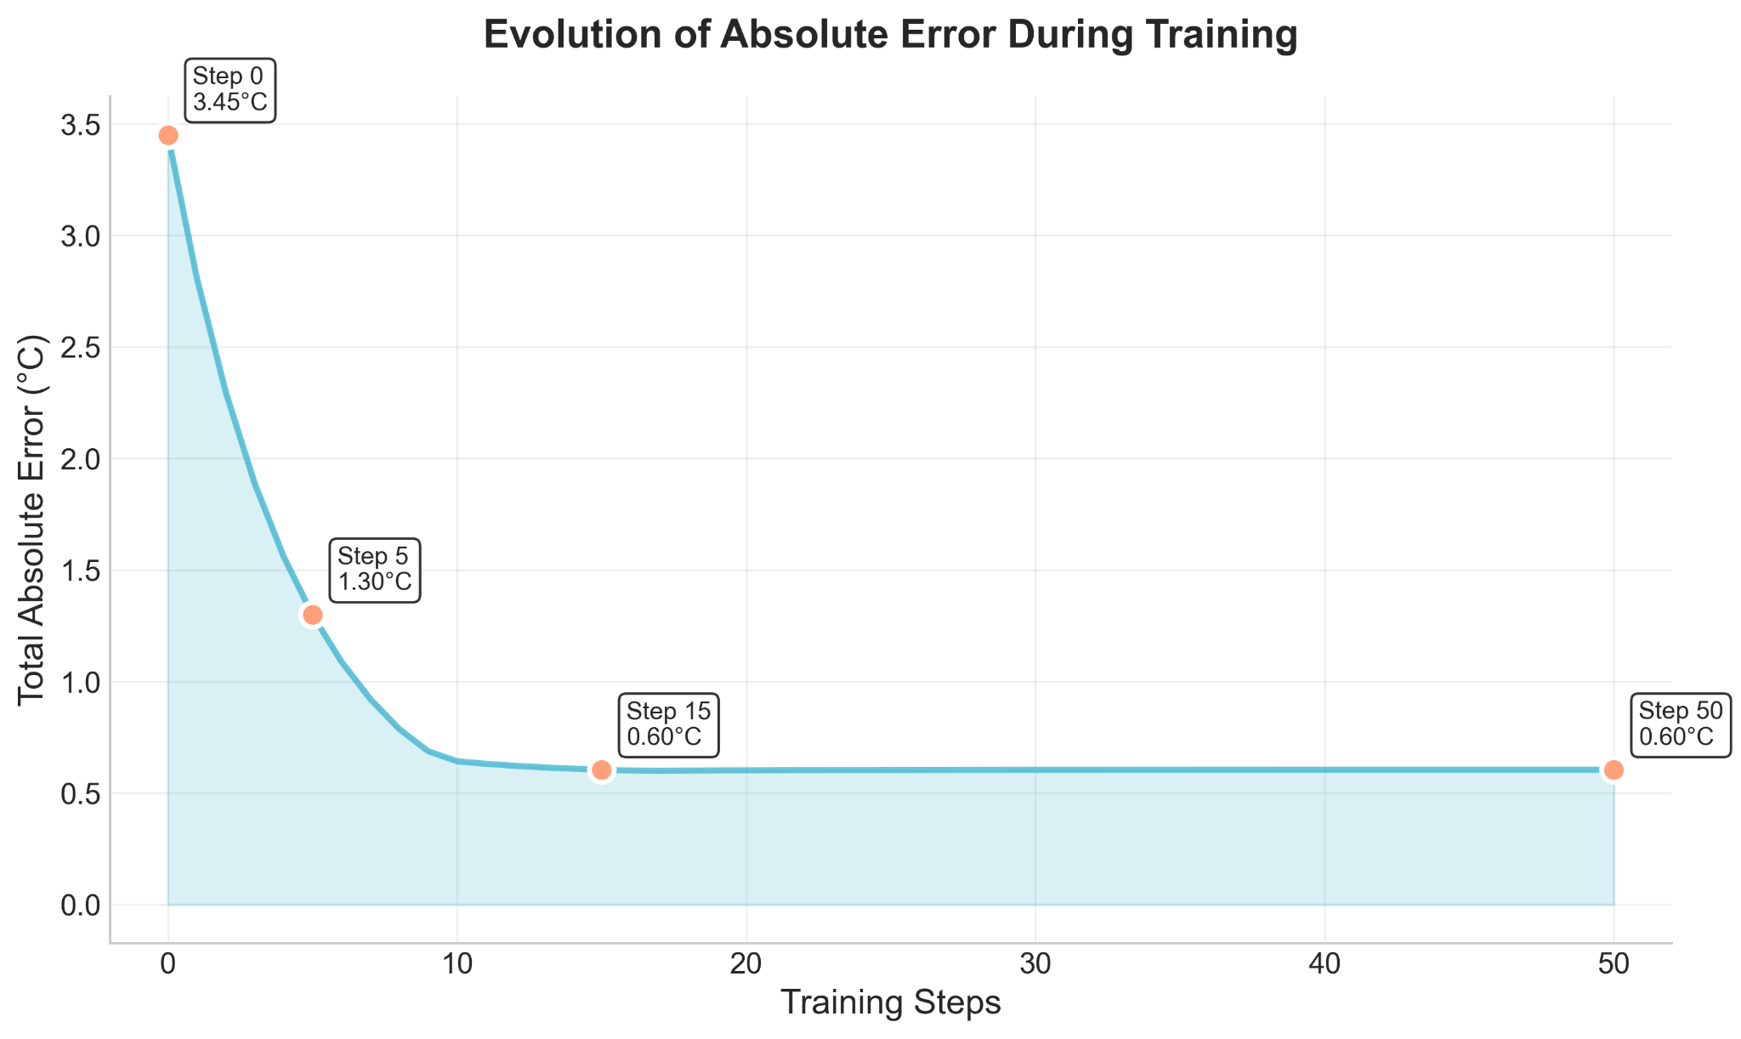
ML : Training example
Initial Model
a=-0.01, b=34.70
Trained Model
a=0.019, b=-23.47
Initial model prediction for 2030
-0.01 * 2030 + 34.70 = 14.4
Trained model prediction for 2030
0.019 * 2030 - 23.47 = 15.1
Raphael Cousin — Sorbonne University

Slide 33

QUIZ : ML framework
What are the two dimensions that characterize data in machine learning?
How are a models parameter values initialized?
How to train a parametric model?
Raphael Cousin — Sorbonne University

Slide 34
Linear Regression

Slide 35


Linear Regression: Setup
is the intercept (bias term)
Each represents the effect of feature j on the prediction. Simple, interpretable, and a powerful baseline.
Raphael Cousin — Sorbonne University

Slide 36
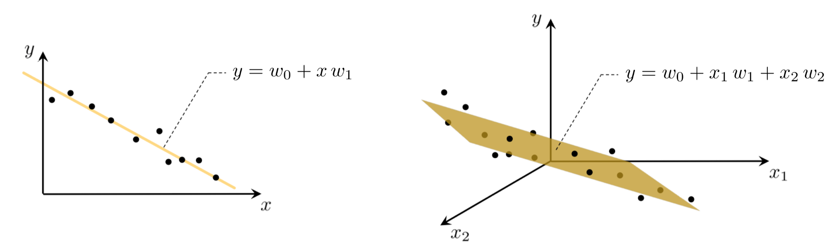
Geometric Intuition
Raphael Cousin — Sorbonne University

Slide 37
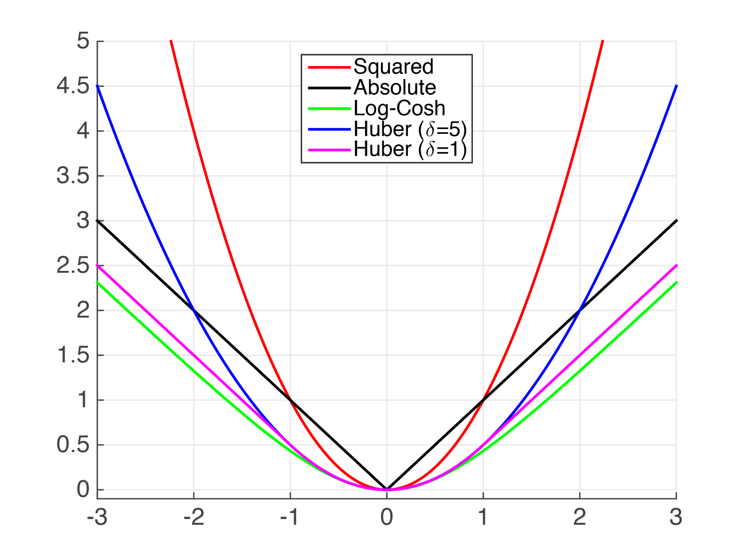
Loss Choice
Mean Squared Error (MSE):
Mean Absolute Error (MAE):
Raphael Cousin — Sorbonne University

Slide 38
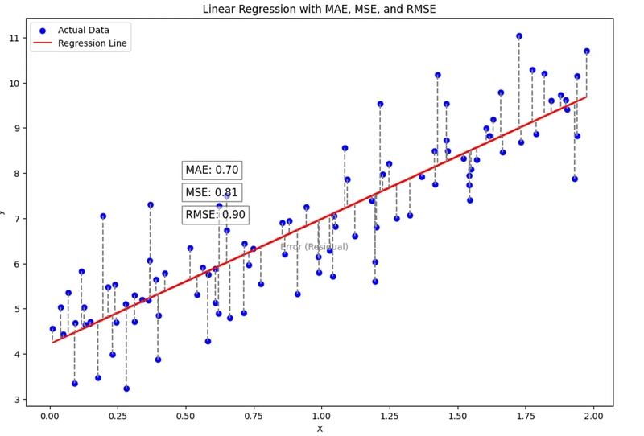
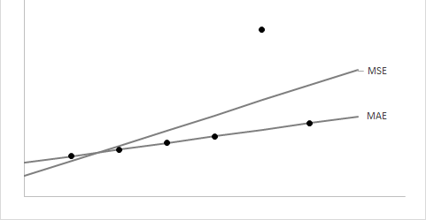
Visual: Residuals
Raphael Cousin — Sorbonne University

Slide 39
Linear Regression in scikit-learn
from sklearn.linear_model import LinearRegression
model = LinearRegression()
model.fit(X_train, y_train)
y_pred = model.predict(X_test)
print(model.coef_, model.intercept_)
sklearn uses the normal equation internally (numerically stable variant).
API pattern: fit() → predict() — same for every model in the course.
Raphael Cousin — Sorbonne University

Slide 40
Example: Housing Dataset
Surface (m²) | Rooms | Dist. center (km) | Price (€)
55 | 2 | 3.2 | 185,000
80 | 3 | 1.5 | 320,000
120 | 4 | 5.0 | 280,000
45 | 1 | 0.8 | 250,000
95 | 3 | 2.1 | 350,000
Features X = [surface, rooms, distance] Target y = price
Raphael Cousin — Sorbonne University

Slide 41
Interpreting Coefficients
price = 3200 x surface - 1500 x distance + 45000
θ₁ = 3,200
Each m² adds €3,200 to the price
θ₂ = −1,500
Each km from center removes €1,500
θ₀ = 45,000
Base price when all features = 0
Raphael Cousin — Sorbonne University

Slide 42
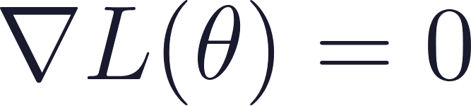
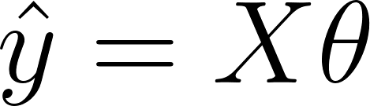
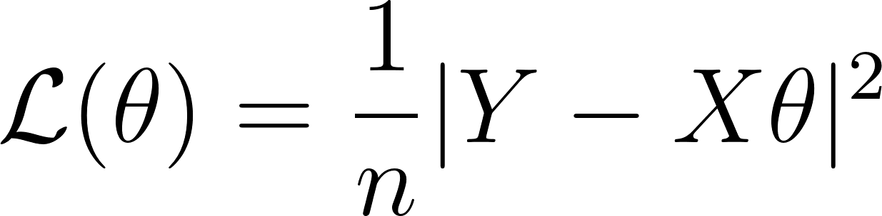
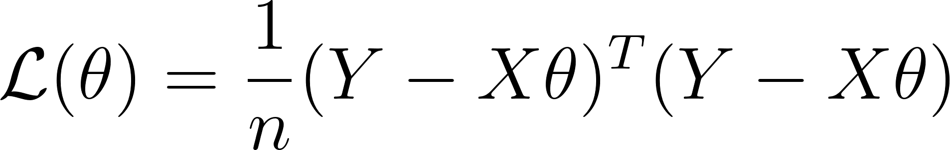
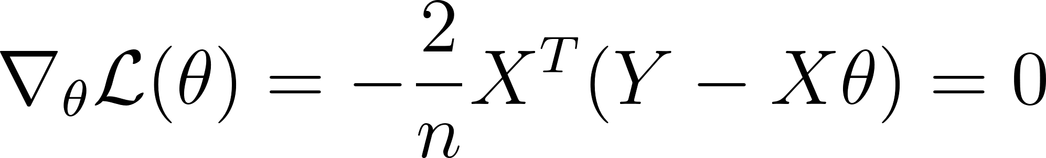


The Normal Equation for MSE
Set gradient to zero:

Slide 43


The Normal Equation for MSE
Set gradient to zero:
Requires to be invertible (fails with collinear features)
Pros
Cons
Exact solution
No hyperparameters
Fast for small/medium data
O(p^3) complexity
Doesn't scale to large p
Requires invertibility
Raphael Cousin — Sorbonne University

Slide 44
Logistic Regression

Slide 45

From Regression to Classification
Problem
Can we use linear regression?
Predictions can go below 0 and above 1
Raphael Cousin — Sorbonne University

Slide 46


The Sigmoid Function
→ Output ∈ (0, 1)
→ Maps ℝ → probability
→ σ(0) = 0.5
→ Smooth & differentiable
Raphael Cousin — Sorbonne University

Slide 47


Logistic Regression Model
1
Compute
Same linear combination as before
2
Apply sigmoid:
Output is now a "probability" (between 0 and 1)
3
Decision: predict 1 if P > 0.5, else 0
Threshold for classification
Raphael Cousin — Sorbonne University

Slide 48

Why Not MSE for Classification?
MSE + sigmoid
= non-convex
Multiple local minima where gradient descent can get stuck.
We need a different loss function.
Raphael Cousin — Sorbonne University

Slide 49

Cross-Entropy Loss (Log Loss)
If y = 1
If y = 0
Penalizes low ŷ
Penalizes high ŷ
Raphael Cousin — Sorbonne University

Slide 50
Trained model
Raphael Cousin — Sorbonne University

Slide 51
Logistic Regression in scikit-learn
from sklearn.linear_model import LogisticRegression
model = LogisticRegression()
model.fit(X_train, y_train)
y_pred = model.predict(X_test)
y_proba = model.predict_proba(X_test)[:, 1]
predict_proba() returns actual probabilities, not just class labels.
Same API as LinearRegression — different model, different learning method, same interface.
Raphael Cousin — Sorbonne University

Slide 52
QUIZ
Why can't we use linear regression directly for classification?
What is the role of the sigmoid function in logistic regression?
Why do we use cross-entropy loss instead of MSE for logistic regression?
A logistic regression model outputs P(y=1|x) = 0.73. What class do we predict with a threshold of 0.5? What about with a threshold of 0.8?
How many parameters does a linear regression model have with 5 input features?
Raphael Cousin — Sorbonne University

Slide 53
ML : Exemple d'entraînement Regression
Modèle initial
a=-0.01, b=34.70
Modèle entraîné
a=0.019, b=-23.47
Prédiction pour 2030
-0.01 * 2030 + 34.70 = 14.4
Prédiction pour 2030
0.019 * 2030 - 23.47 = 15.1
Raphael Cousin — Sorbonne University
trajectoire de la descente de gradient dans l'espace des paramètres

Slide 54
ML : Exemple d'entraînement Classification
Binary cross entropy
Modèle initial
a=0.19, b=-1.17
Modèle entraîné
a=-1.01, b=1.6
Prédiction pour (1.4,1.2)
bleu
Prédiction pour (1.4,1.2)
rouge
Raphael Cousin — Sorbonne University
trajectoire de la descente de gradient dans l'espace des paramètres

Slide 55
Visualization and prepare the data

Slide 56
Missing Values

Slide 57

Missing data
Data not collected: Information might not be collected, either due to oversight or because it was not available.
Data corruption: During data transfer or storage, data might get corrupted leading to missing entries.
Raphael Cousin — Sorbonne University

Slide 58

Missing data - Visualization
import seaborn as sns
sns.heatmap(df.isnull(), cbar=False)
Raphael Cousin — Sorbonne University

Slide 59
Missing data - Strategy 1: Drop
df.dropna() # drop rows with any NaN
df.dropna(subset=['age']) # only where 'age' is NaN
df.dropna(thresh=3) # keep rows with ≥3 non-NaN
When to use
Risk
Few missing values (<5%)
Missing completely at random
Lose data
Bias if missing is not random
Raphael Cousin — Sorbonne University

Slide 60

Missing data - Strategy 2: Imputation
Mean/Median/Mode Imputation Missing values can often be imputed using central tendency measures such as the mean, median, or mode. This is one of the simplest methods and is particularly effective when the data does not exhibit high variance.
from sklearn.impute import SimpleImputer
imputer = SimpleImputer(strategy='mean')
# also: 'median', 'most_frequent'
df[['age']] = imputer.fit_transform(df[['age']])
Raphael Cousin — Sorbonne University

Slide 61

Missing data - Strategy 2: Forward Fill
For time series data, you might consider using methods like forward fill where you propagate the last observed data point to the next missing value.
# Forward fill (time series)
df['temp'] = df['temp'].ffill()
Raphael Cousin — Sorbonne University

Slide 62

Missing data - Strategy 4: Predict
K-Nearest Neighbors K-Nearest Neighbors can be used to impute missing values based on the similarities between features. It is more sophisticated than mean/median imputation and can provide more accurate results for complex datasets.
# Forward fill (time series)
df['temp'] = df['temp'].ffill()
# Interpolation (linear estimate between known)
df['temp'] = df['temp'].interpolate(method='linear')
# KNN Imputer (use similar rows)
from sklearn.impute import KNNImputer
imputer = KNNImputer(n_neighbors=5)
df_imputed = imputer.fit_transform(df)
Raphael Cousin — Sorbonne University

Slide 63
Missing data - Strategy 5: domain knowledge
Domain | Missing ≠ Random — It Means Something | Fix
Medicine | Lab not ordered → patient was fine | Impute normal, not mean-of-sick
Finance | No price → market closed | Forward-fill, never mean
Sensors | Gap → sensor died, not random | neighbor sensor
Credit | No mortgage history → never had one | Encode missingness as feature
E-commerce | No rating → didn't care enough | Implicit feedback, not ignore
Raphael Cousin — Sorbonne University

Slide 64
Outliers

Slide 65



Outliers : error or signal?
Errors
Real Signal
Sensor malfunction
Data entry mistake
ETL bug
Legitimate extreme values
Rare but real events
Important for the model
Raphael Cousin — Sorbonne University

Slide 66

Outliers Detection: IQR Method
Q1 = df['col'].quantile(0.25)
Q3 = df['col'].quantile(0.75)
IQR = Q3 - Q1
lower = Q1 - 1.5 * IQR
upper = Q3 + 1.5 * IQR
outliers = df[(df['col'] < lower)
| (df['col'] > upper)]
IQR (Interquartile Range) : captures the spread of the middle 50% of your data.
Interpretation:
Large IQR → high variance/spread in the central bulk of the data. Values are dispersed widely.
Small IQR → low variance. Data points are tightly clustered around the median.
Raphael Cousin — Sorbonne University

Slide 67

Outliers Detection: Z-Score
from scipy import stats
z_scores = np.abs(stats.zscore(df['col']))
outliers = df[z_scores > 3]
Z-score: Assumes normal distribution
Raphael Cousin — Sorbonne University

Slide 68

Outliers Strategy
Strategy | Code | When
Remove | df = df[~mask] | Clear errors, few outliers
Clip | df['col'].clip(lo, hi) | Limit extremes
Transform | np.log1p(df['col']) | Reduce skewness
Keep | Do nothing | Legitimate extremes
Raphael Cousin — Sorbonne University

Slide 69
Categorical

Slide 70

Categorical type
Nominal : Categories without inherent order
Ordinal : Categories with a logical order
Raphael Cousin — Sorbonne University

Slide 71

Visualize Categorical Values
# Count plot for 'color'
plt.figure(figsize=(10, 6))
sns.countplot(x='color', data=df, palette='viridis')
plt.title('Count Plot of Colors')
plt.xlabel('Color')
plt.ylabel('Count')
plt.show()
# Bar plot for average rating by color
plt.figure(figsize=(10, 6))
sns.barplot(x='color', y='rating', data=df, ci=None, palette='viridis')
plt.title('Average Rating by Color')
plt.xlabel('Color')
plt.ylabel('Average Rating')
plt.show()
Raphael Cousin — Sorbonne University

Slide 72

Manage Categorical Values : Label Encoding
le = LabelEncoder()
df['color_encoded'] = le.fit_transform(df['color'])
df['size_encoded'] = le.fit_transform(df['size'])
OrdinalEncoder — when categories have natural order
Raphael Cousin — Sorbonne University

Slide 73

Manage Categorical Values : One Hot Encoding
from sklearn.preprocessing import OneHotEncoder
ohe = OneHotEncoder()
encoded = ohe.fit_transform(df[['color', 'size']])
df_encoded = pd.DataFrame(encoded, columns=ohe.get_feature_names_out())
OneHotEncoder — binary columns, no ordering assumed
Raphael Cousin — Sorbonne University

